Slide 1
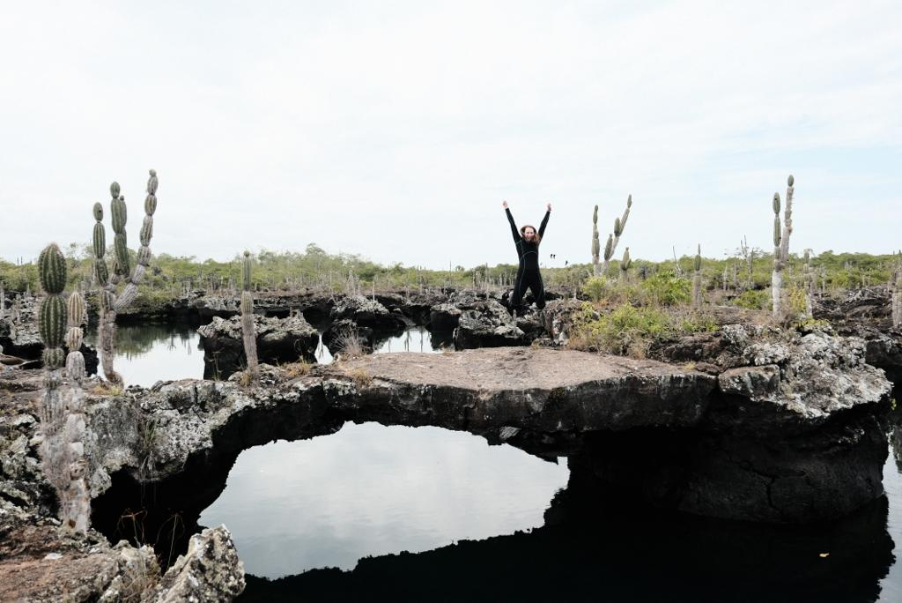
Sara’s Journey to the Galapagos Islands
May 9th – May 22nd 2022

Slide 2
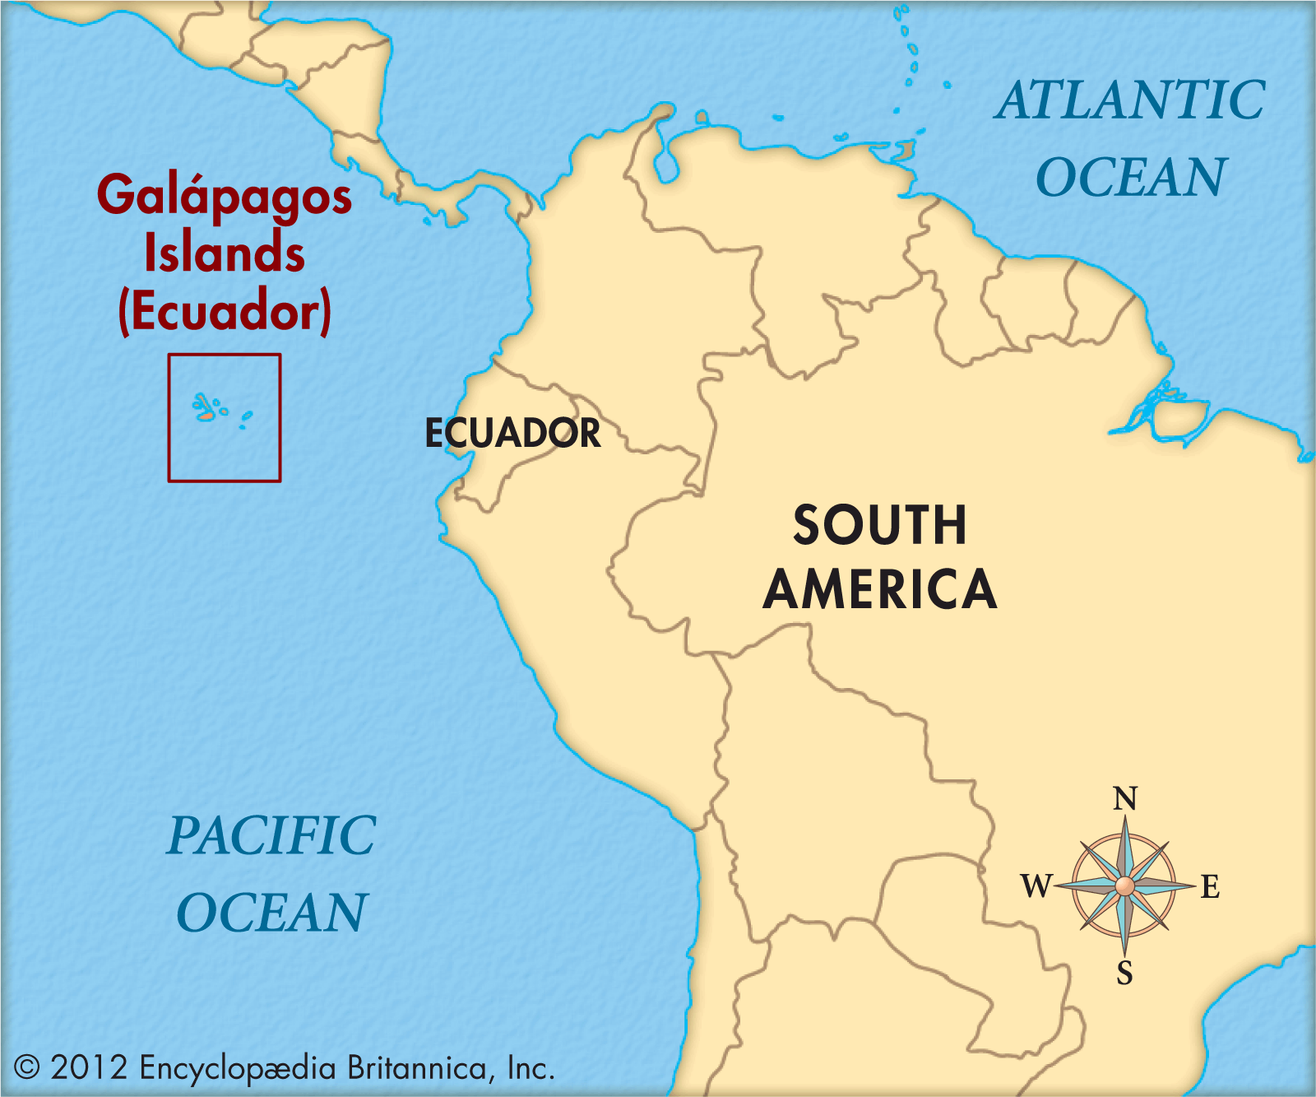
Why the Galapagos?
The Galapagos Islands were formed by volcanic activity millions of years ago. They appeared above the surface 5-10 million years ago.
Wildlife arrived to the islands from the mainland (Ecuador) through strong winds and ocean currents.
They are each geographically isolated at a distance where there is not an inter-change of species. This led to evolution by natural selection. This made the islands perfect for Darwin and preceding scientists to study them.

Slide 3
Meet the Group
We had 19 group members total:
16 AU Students
Dr. Brammell
Dr. Shores
Michelle Kratzer

Slide 4
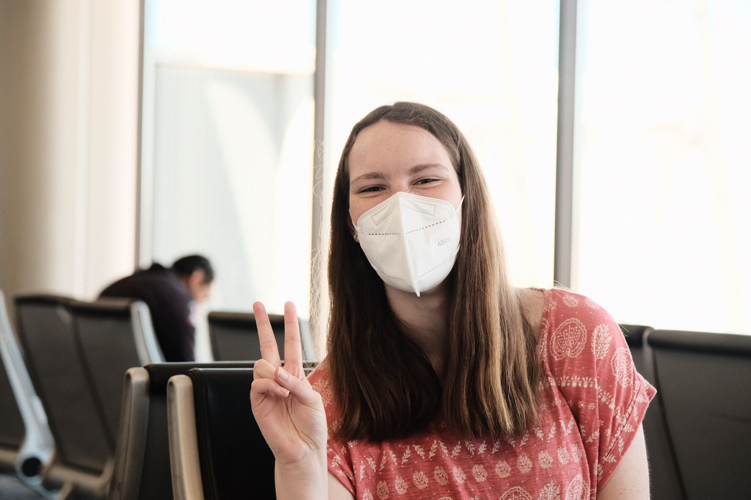
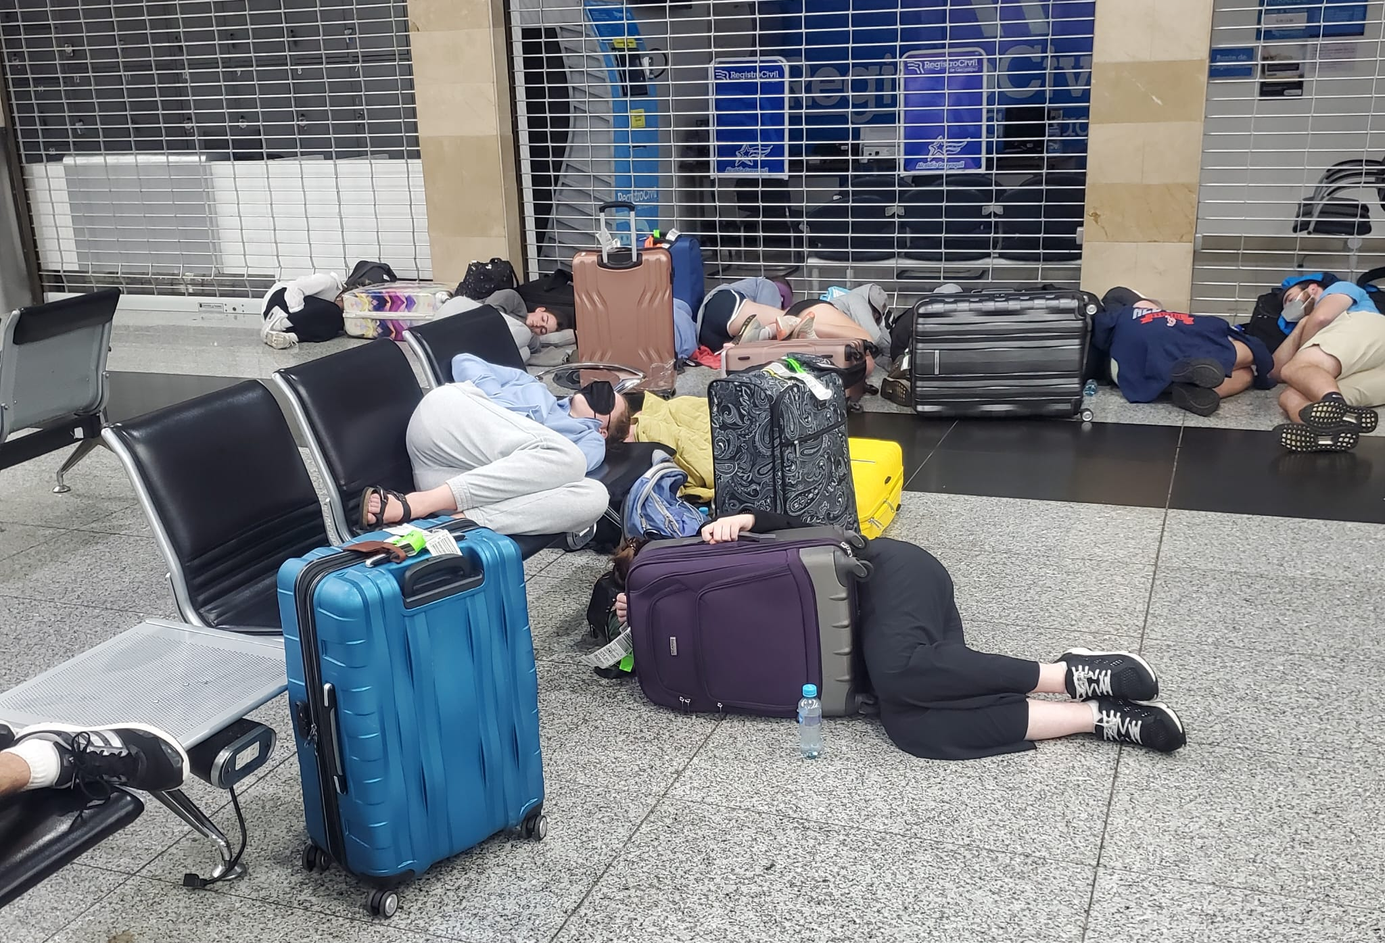
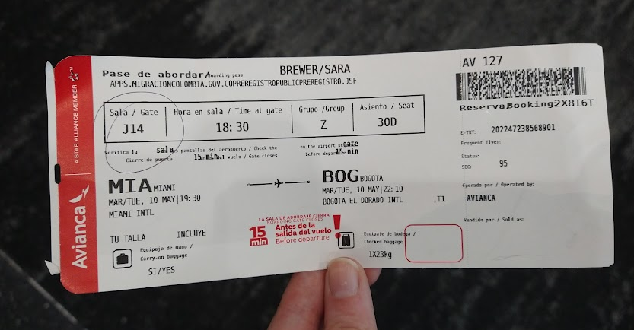
How did you get there, Sara?
We drove from AU to the CVG Airport in Cincinnati, OH. From there we flew to Miami, FL.
We stayed at a hotel in Miami for one night.
The next evening, we flew from Miami to Bogota, Columbia.
From Bogota we flew to Guyaquil, Ecuador. We spent the night in Guyaquil.
The next morning, we flew to the airport on San Cristobal.

Slide 5
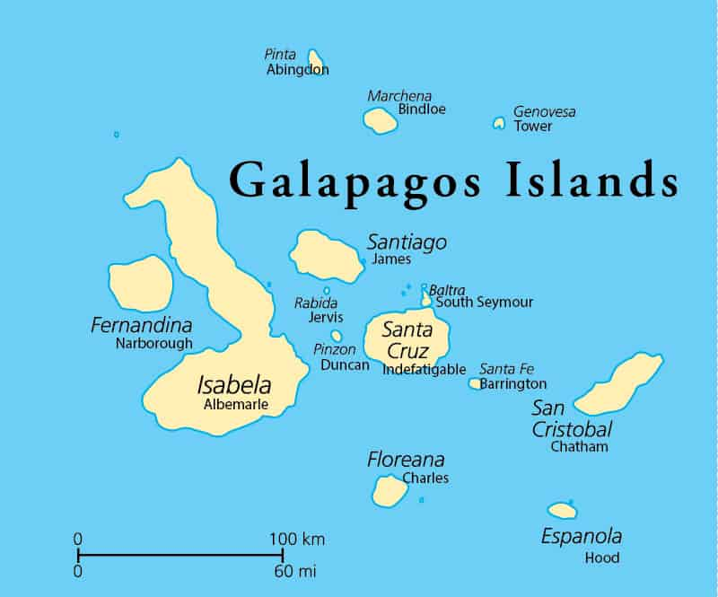
Introducing the Islands

Slide 6
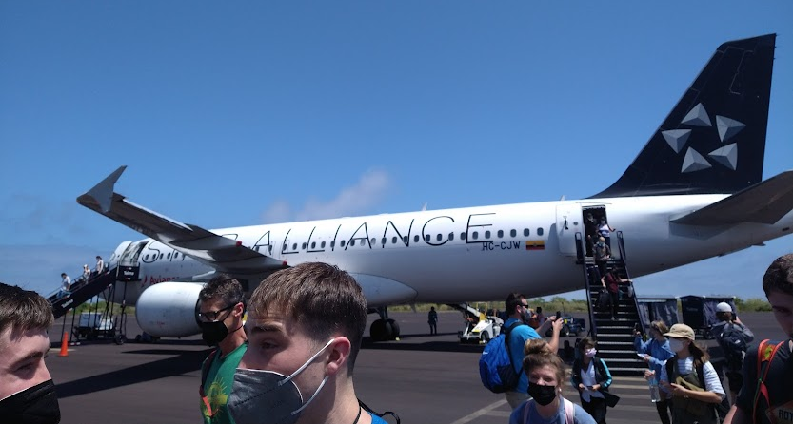
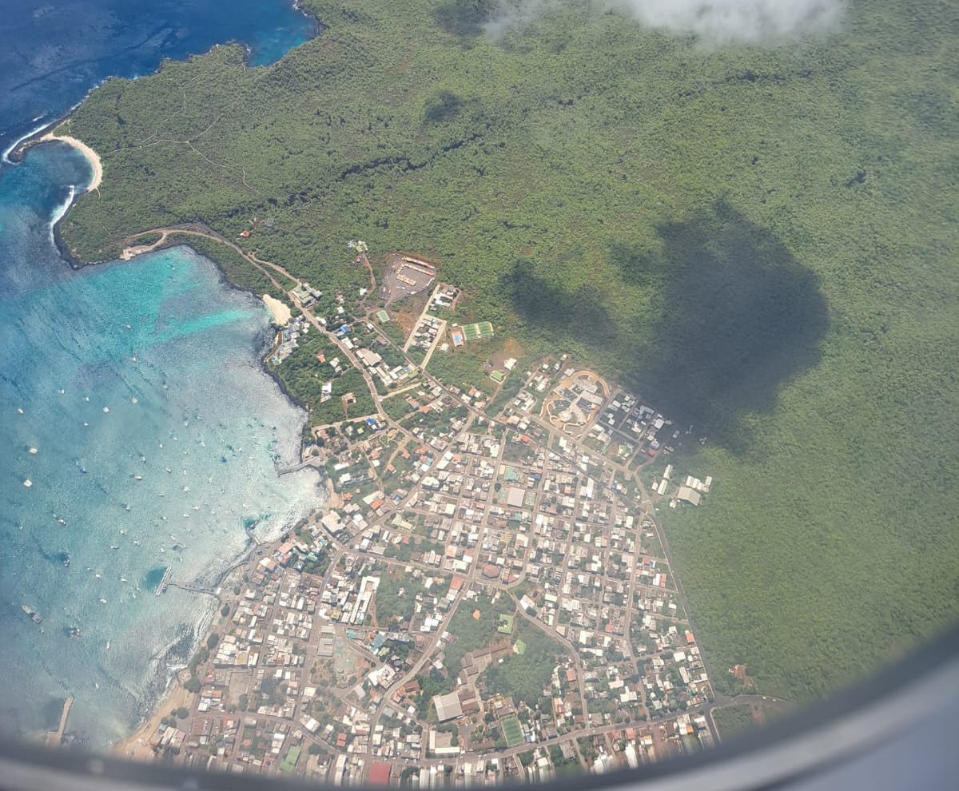
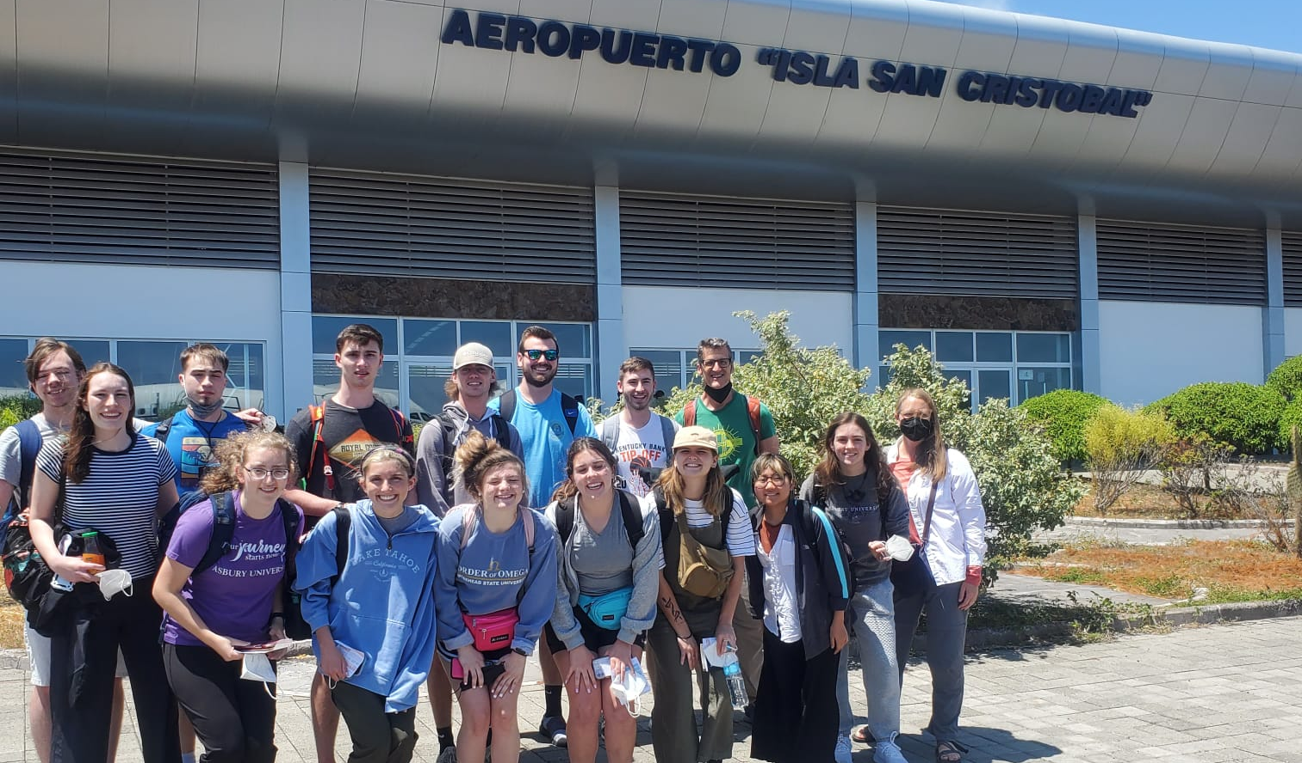
Arriving on San Cristobal

Slide 7
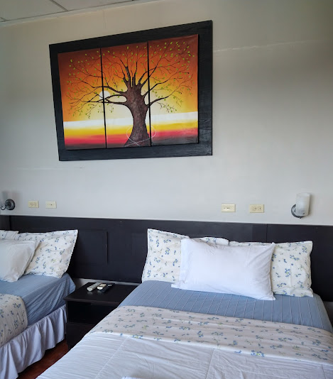
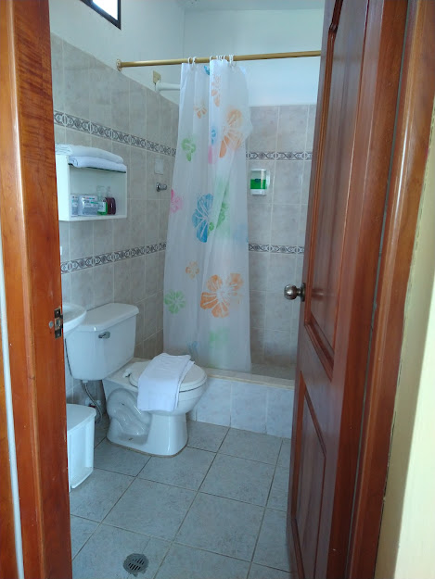
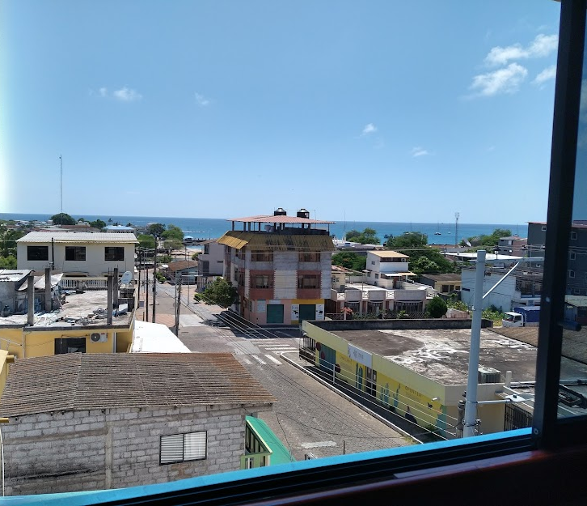
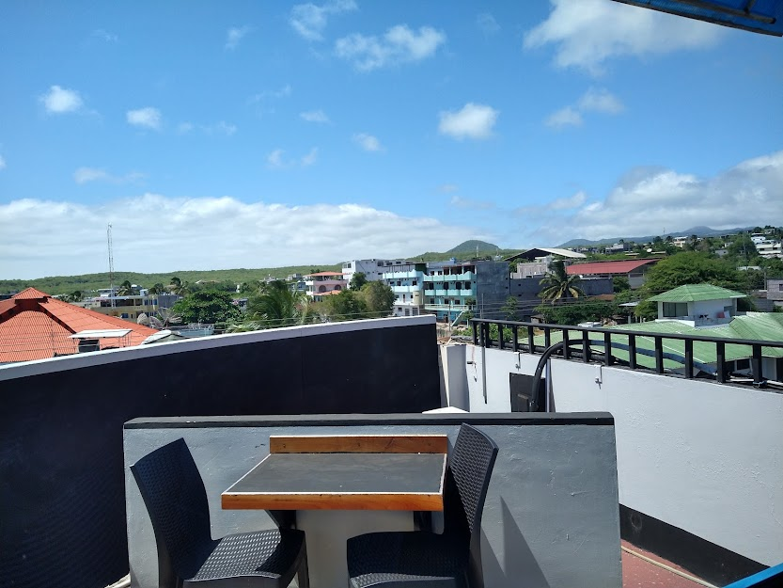
Welcome to the Hotel Algarrobos

Slide 8
Tortoise Breeding Center

Slide 9
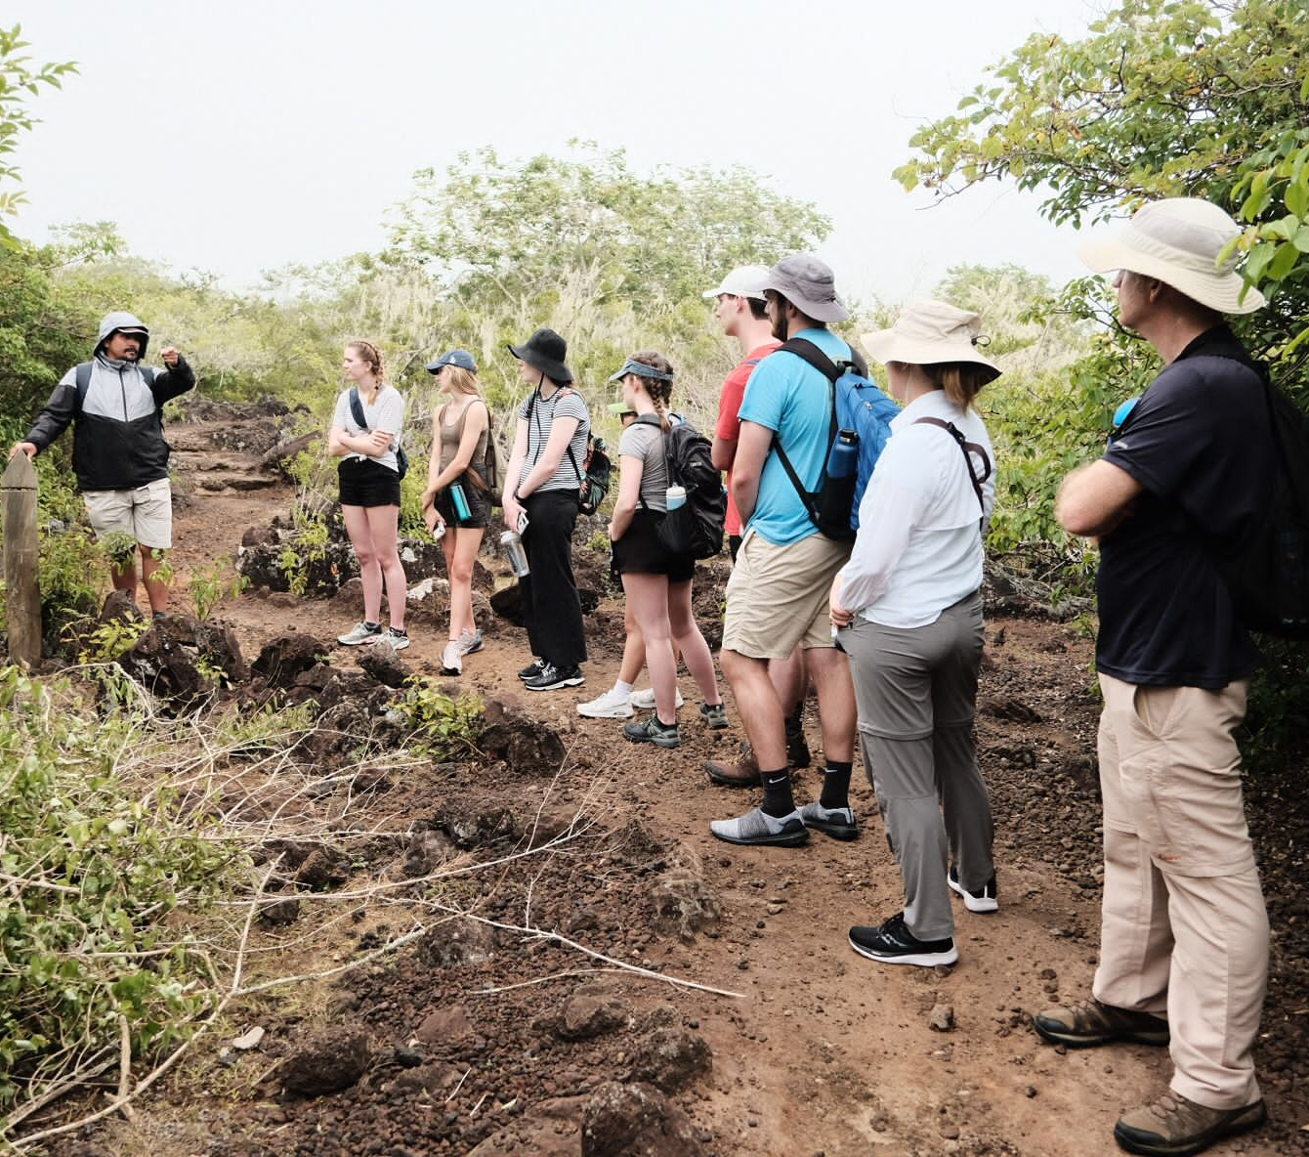

Slide 10
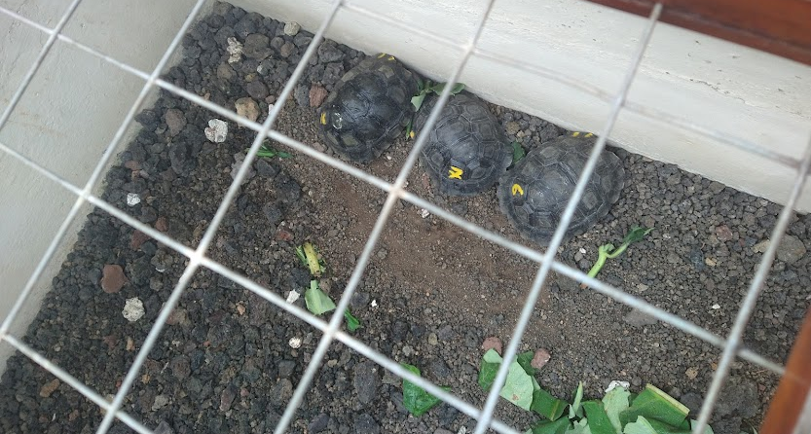
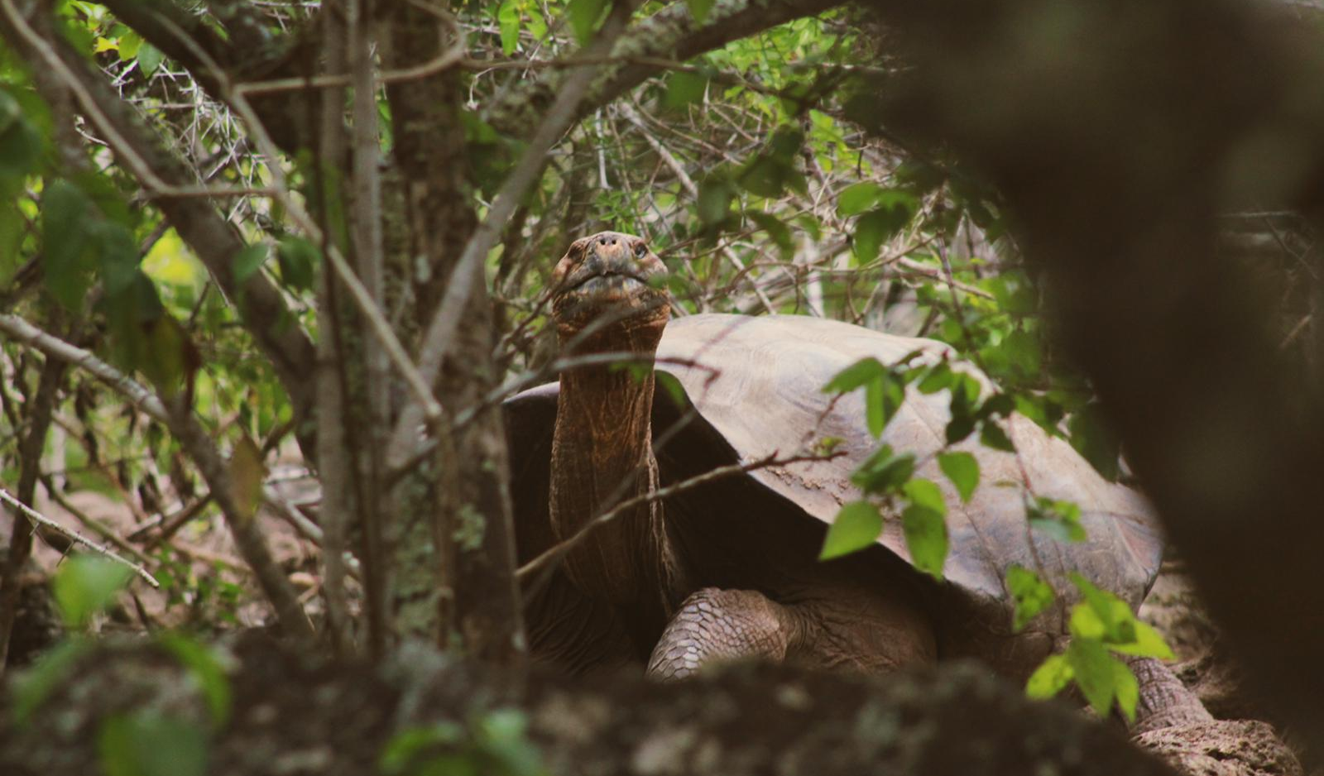
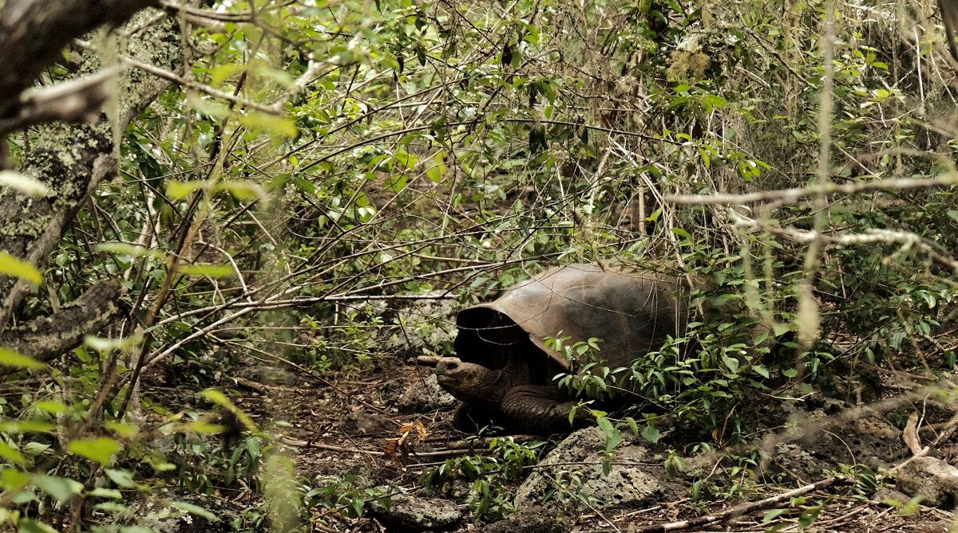

Slide 11
Snorkeling

Slide 12
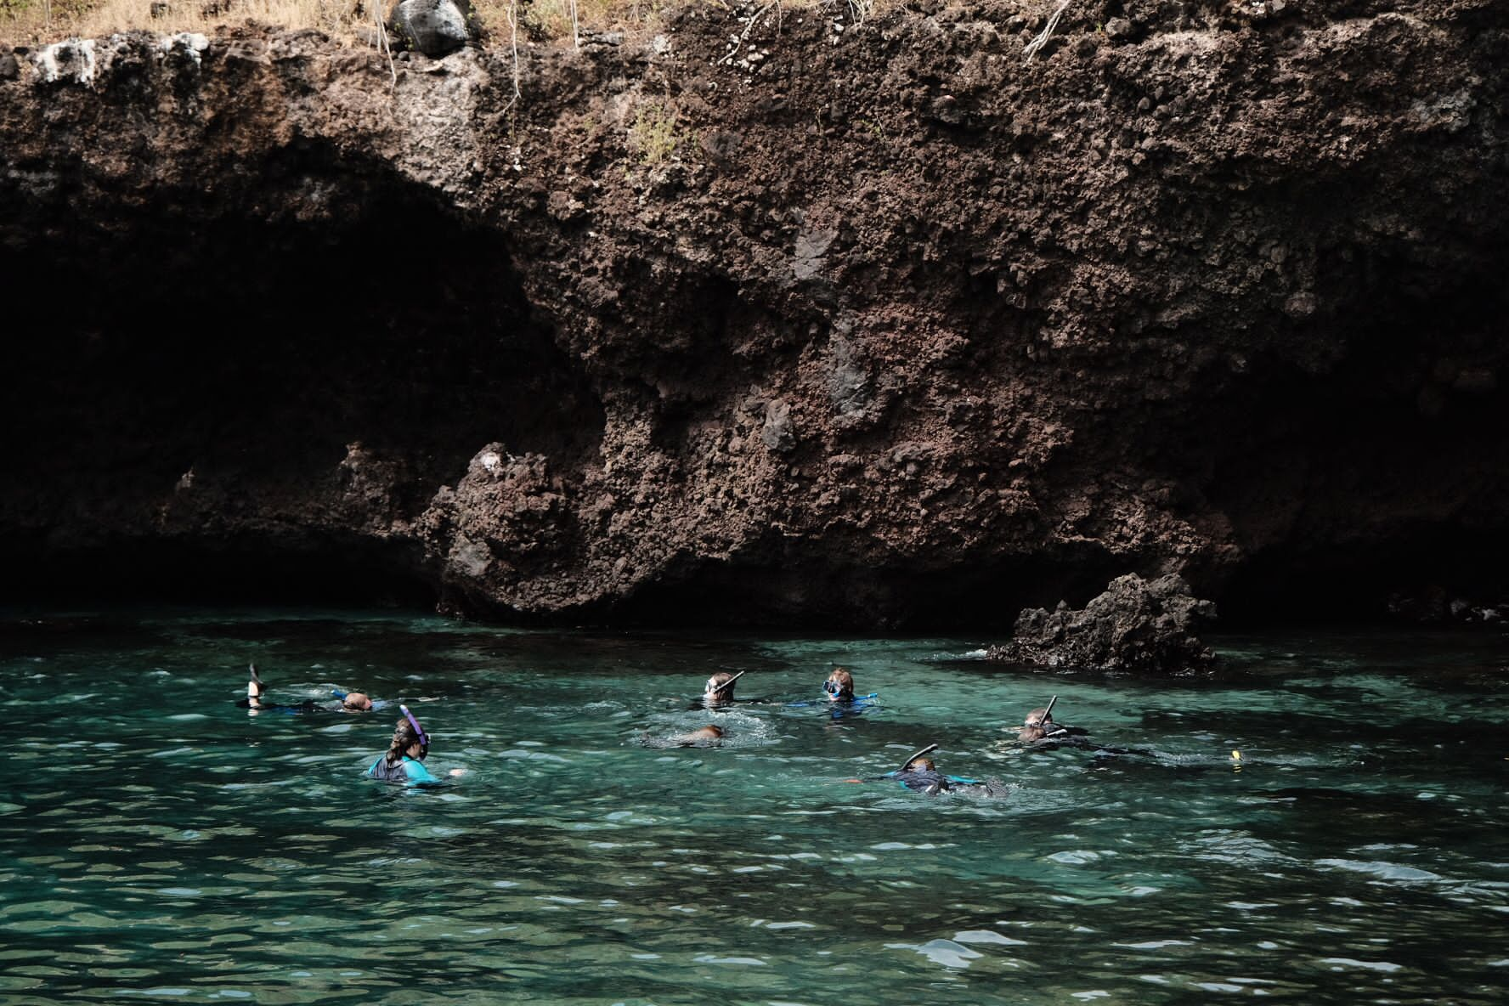
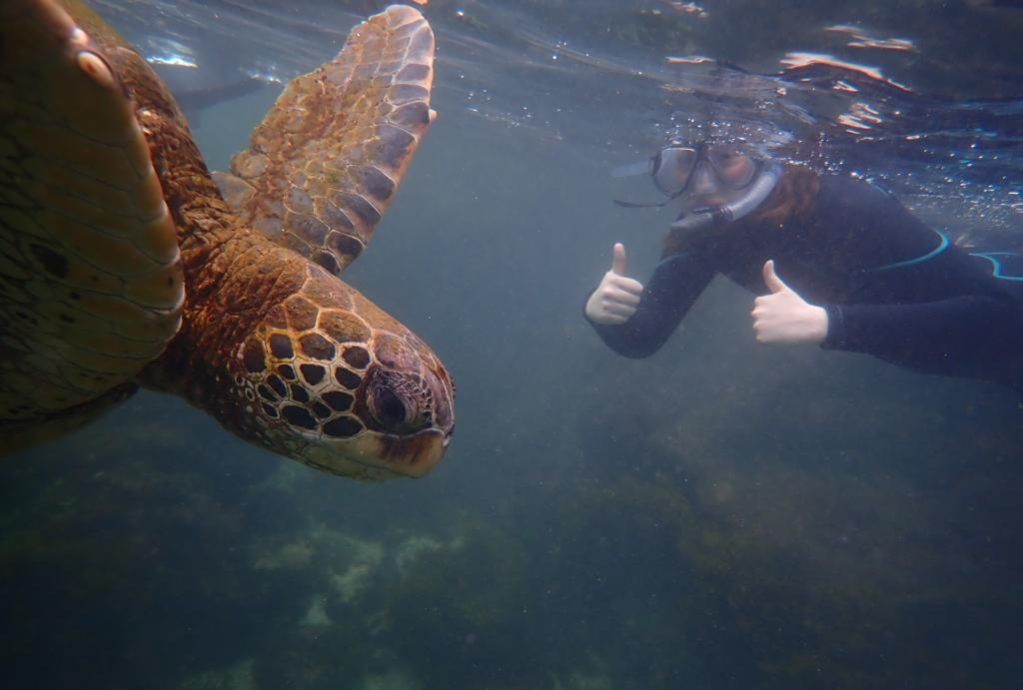

Slide 13
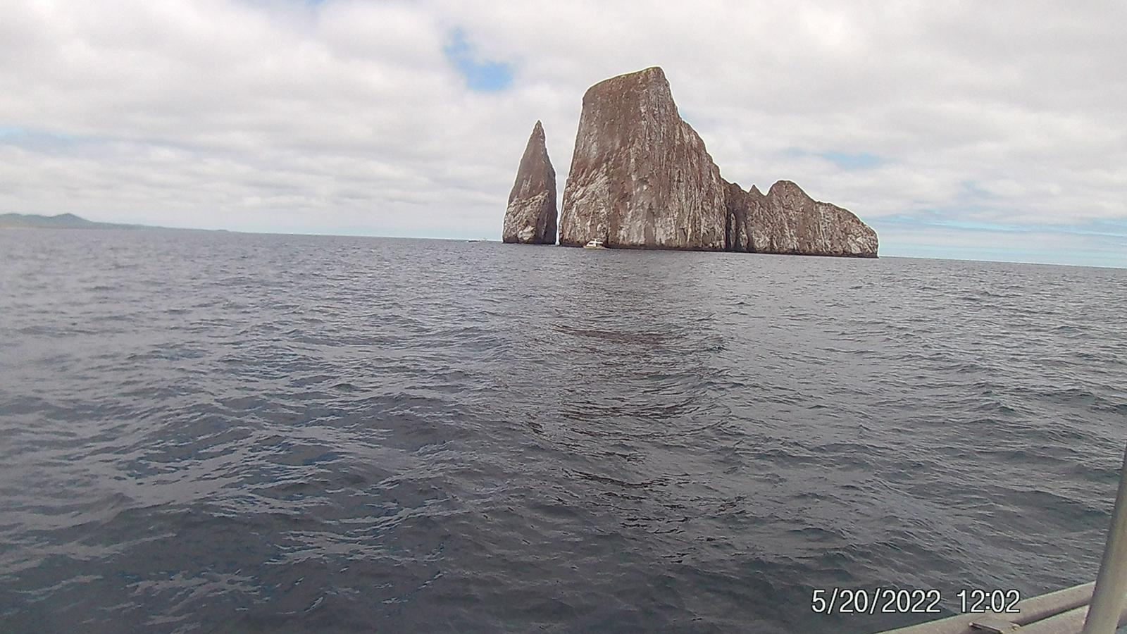
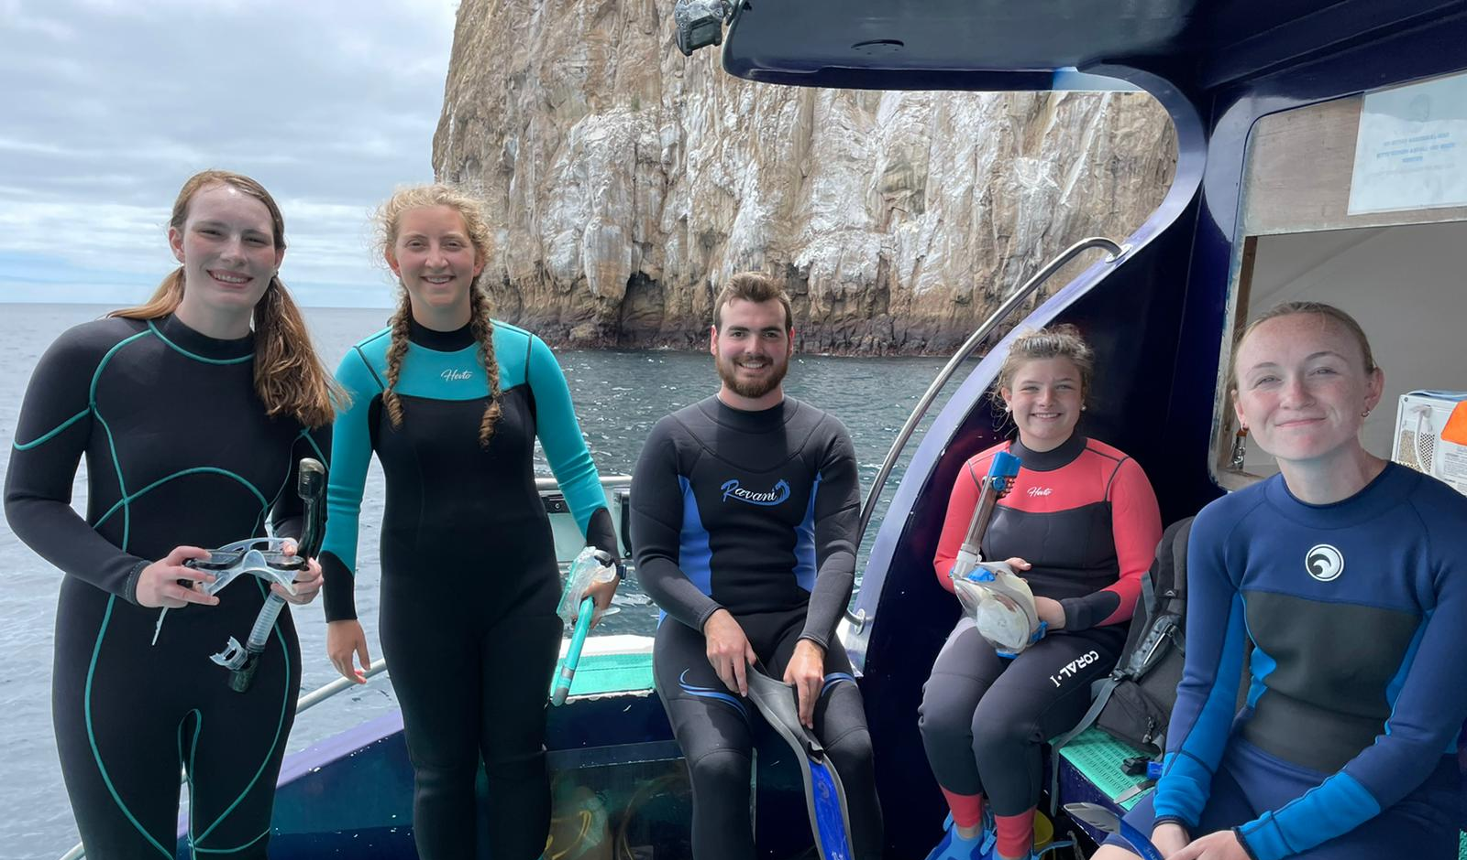
(Last Day)
Kicker Rock

Slide 14
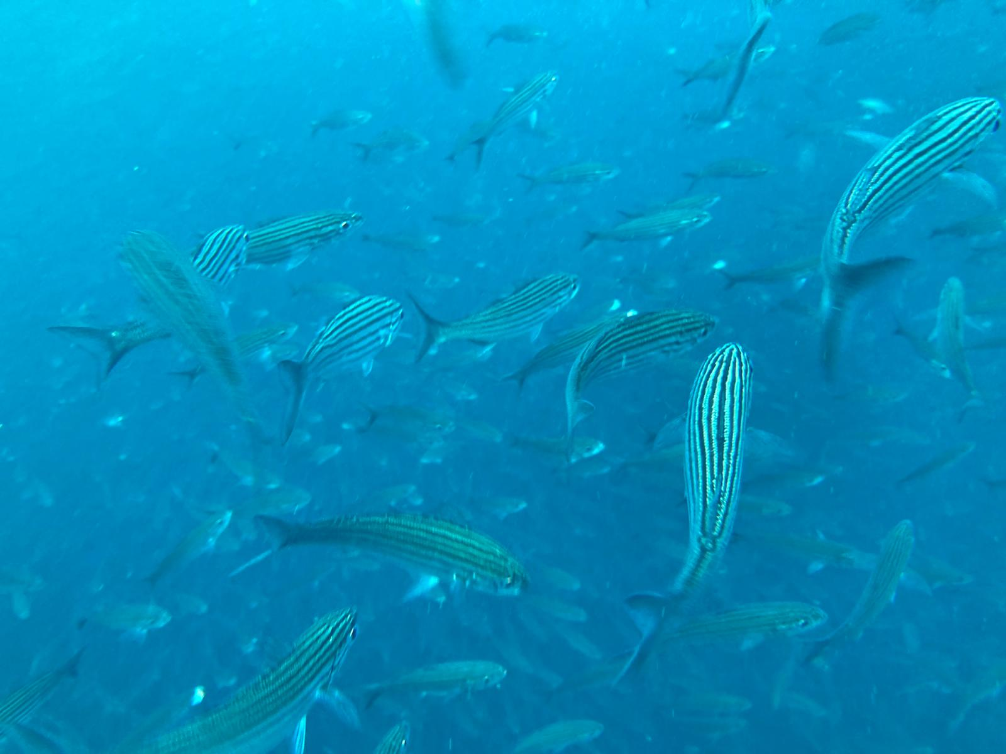
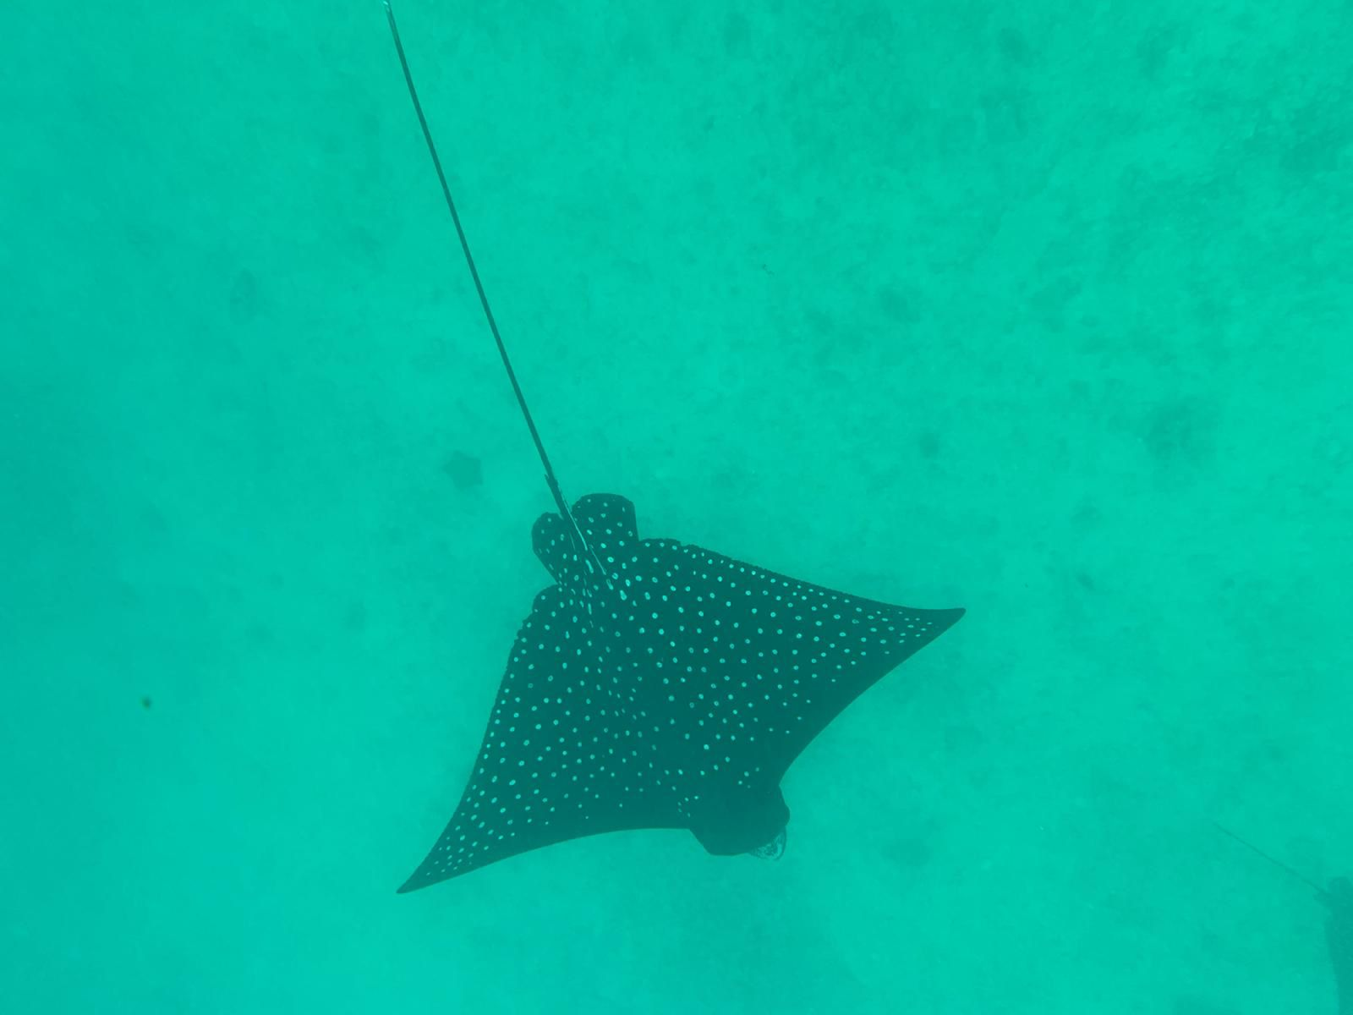
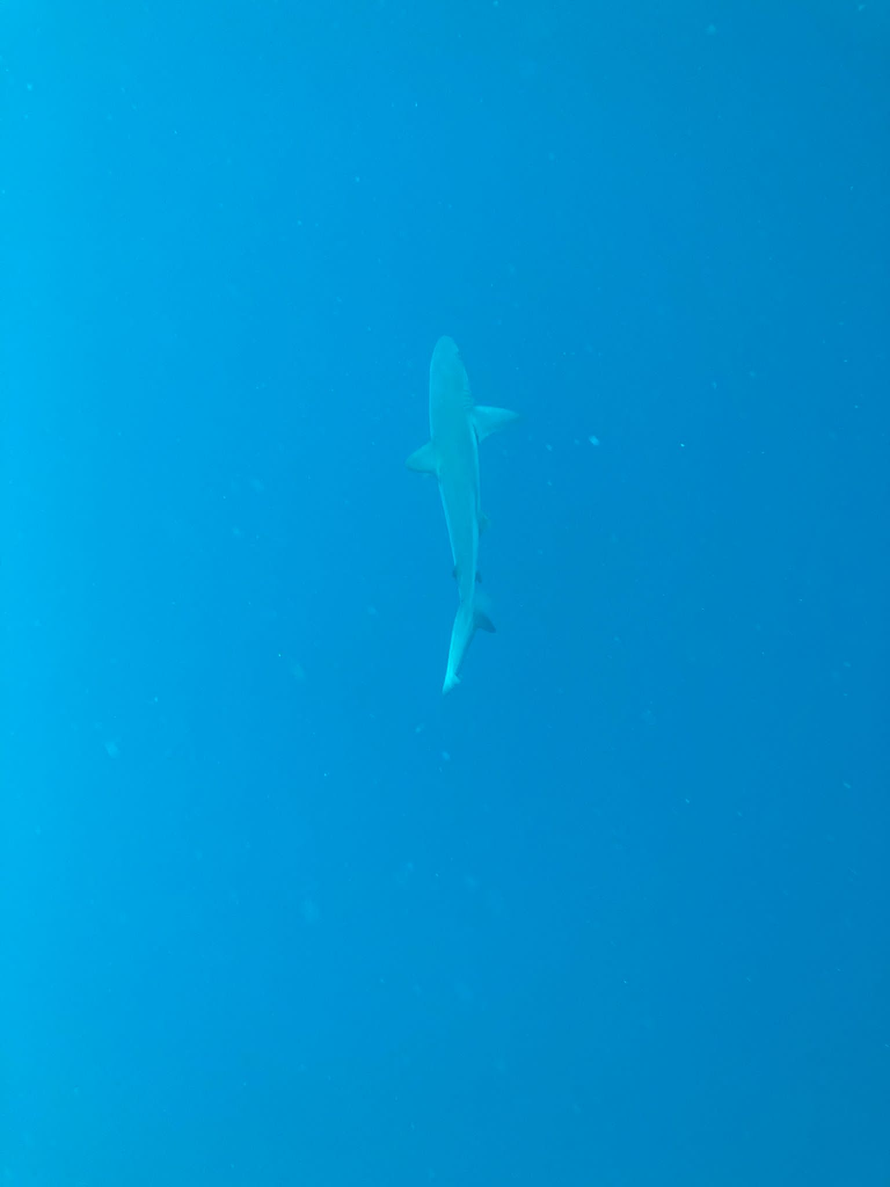
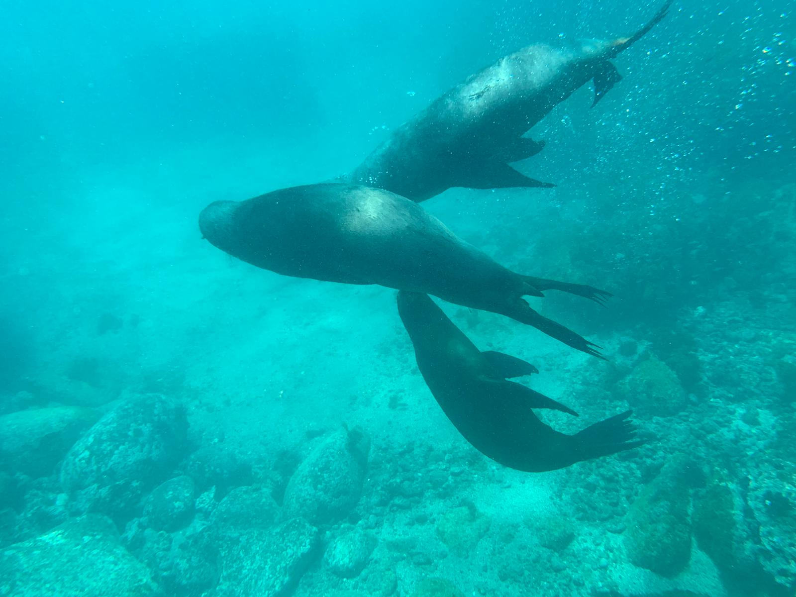
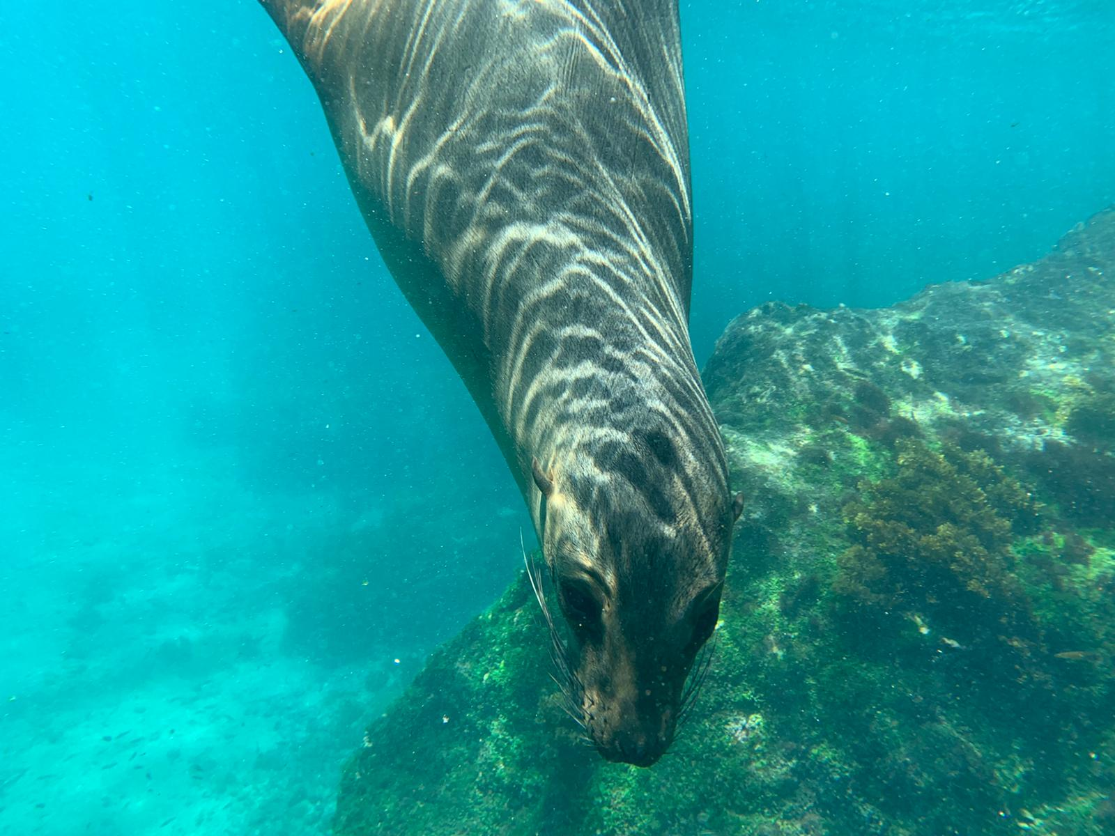
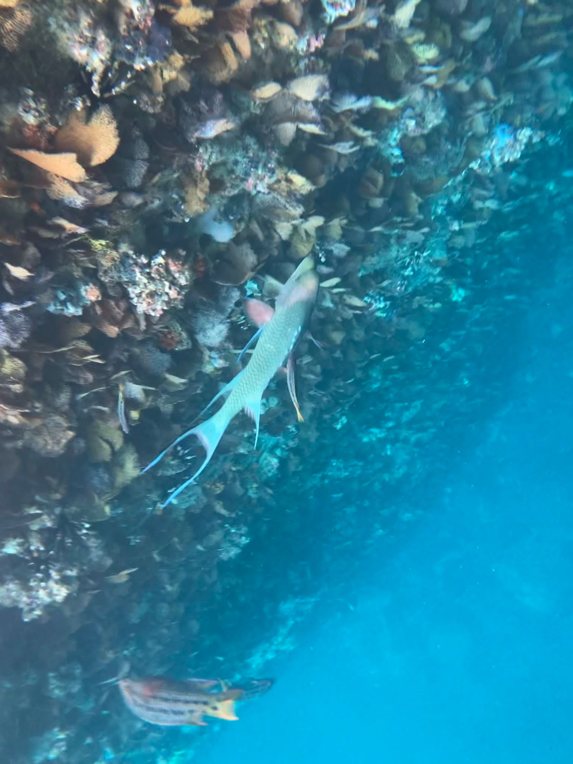

Slide 15
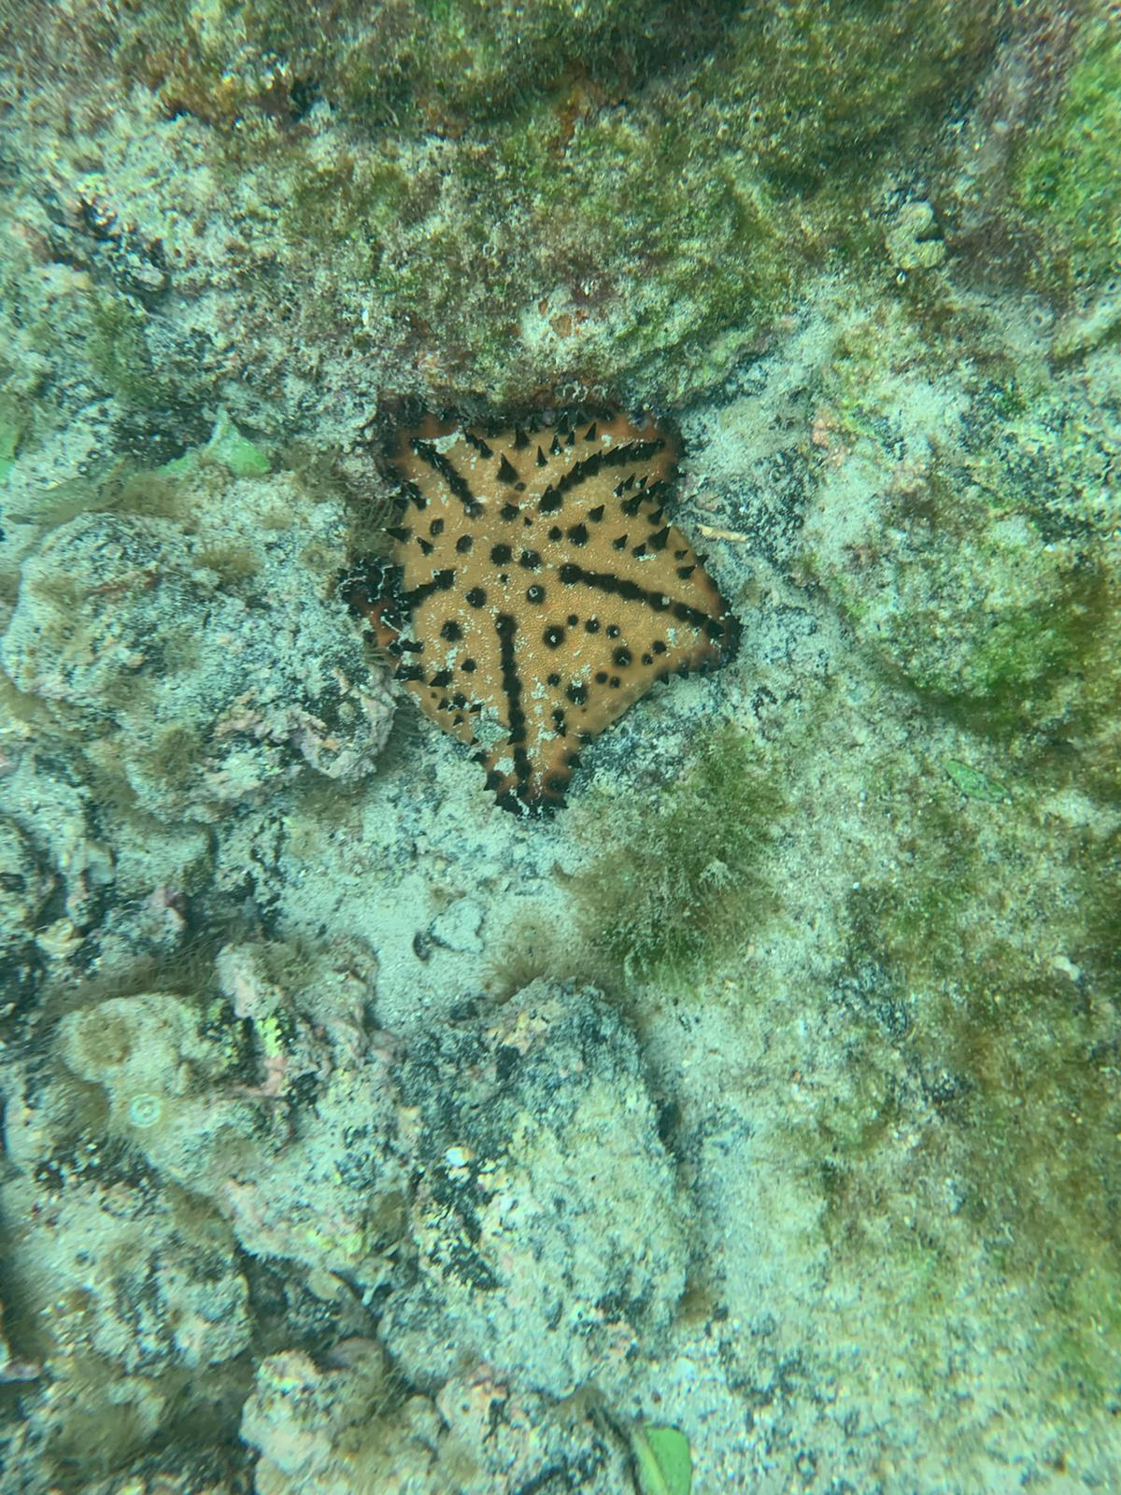
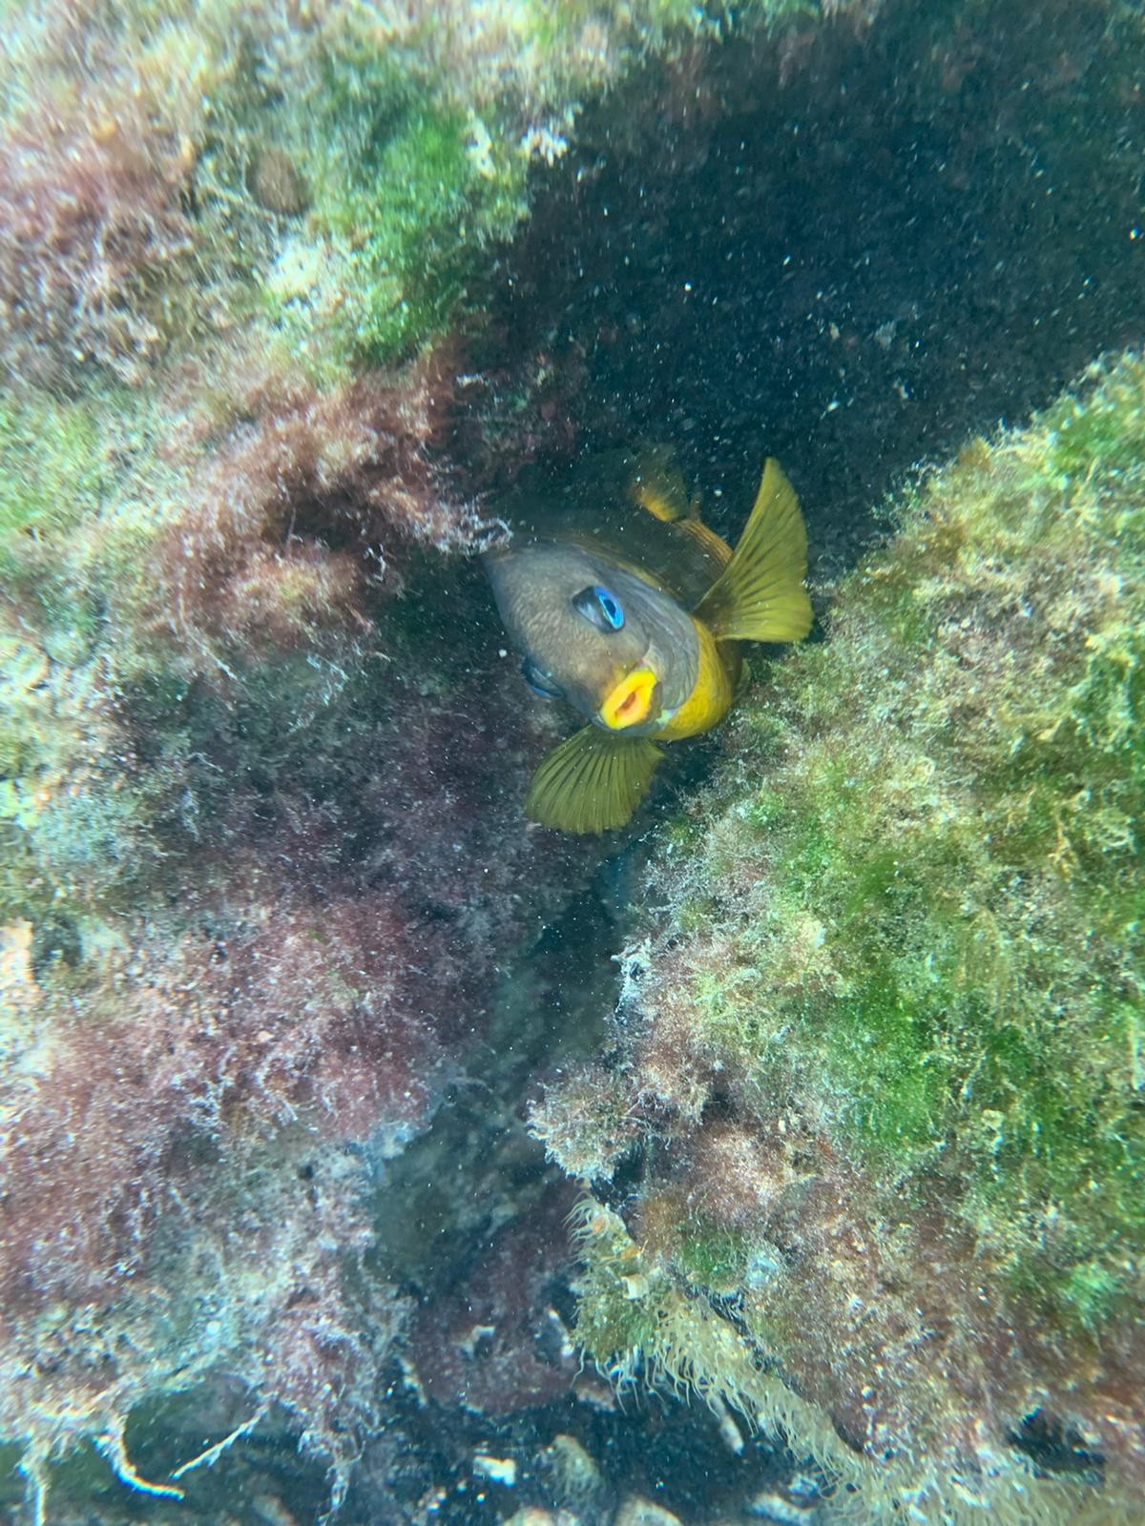
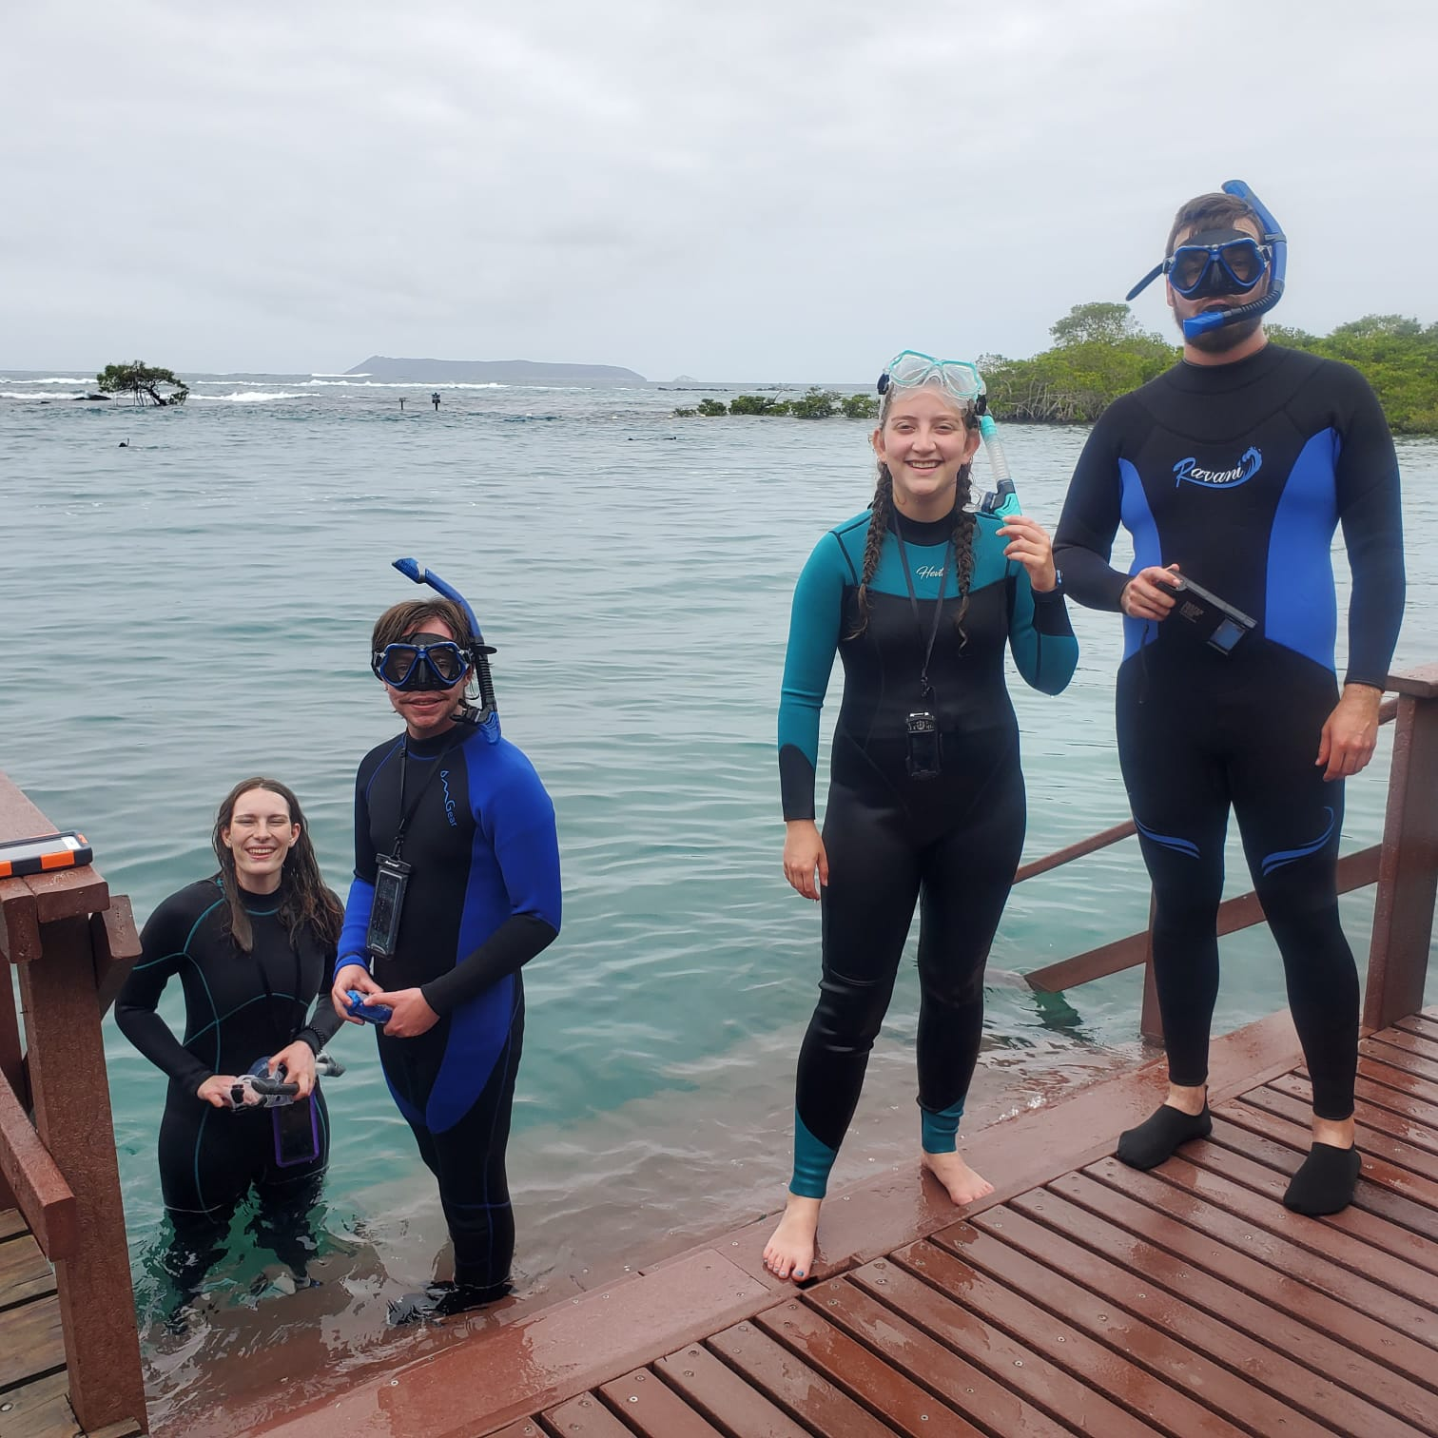

Slide 16
Wall of Tears

Slide 17
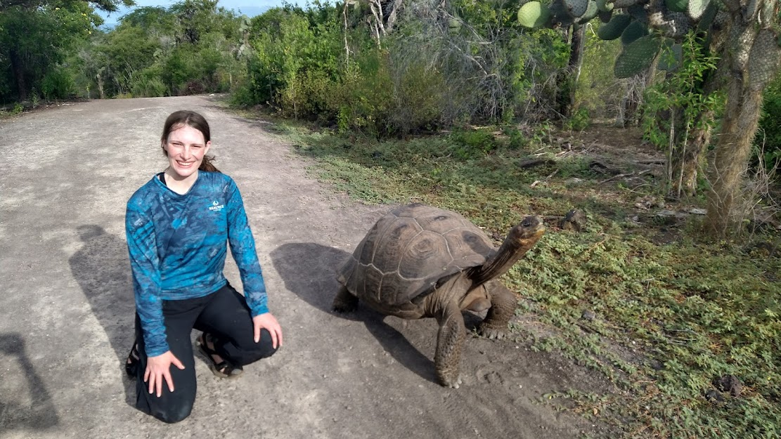
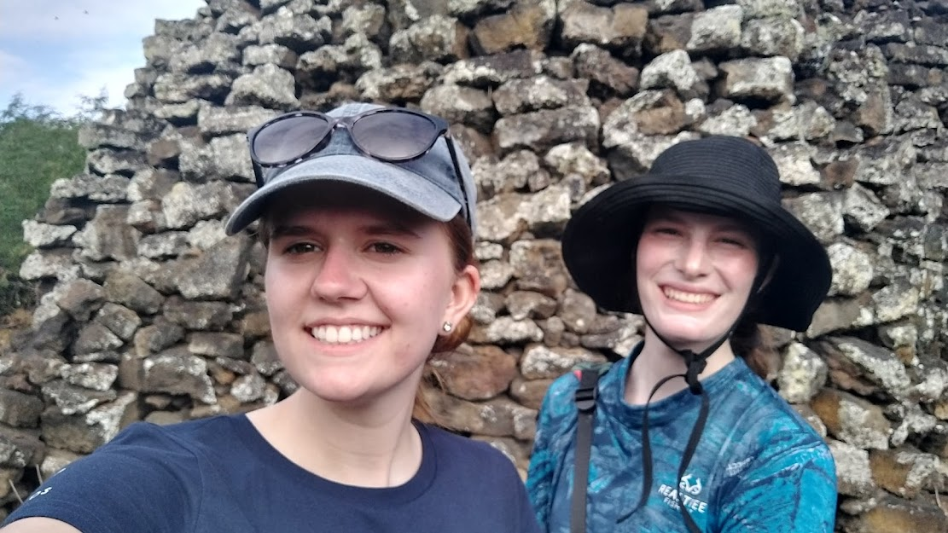

Slide 18
Darwin Research Center & Lonesome George

Slide 19
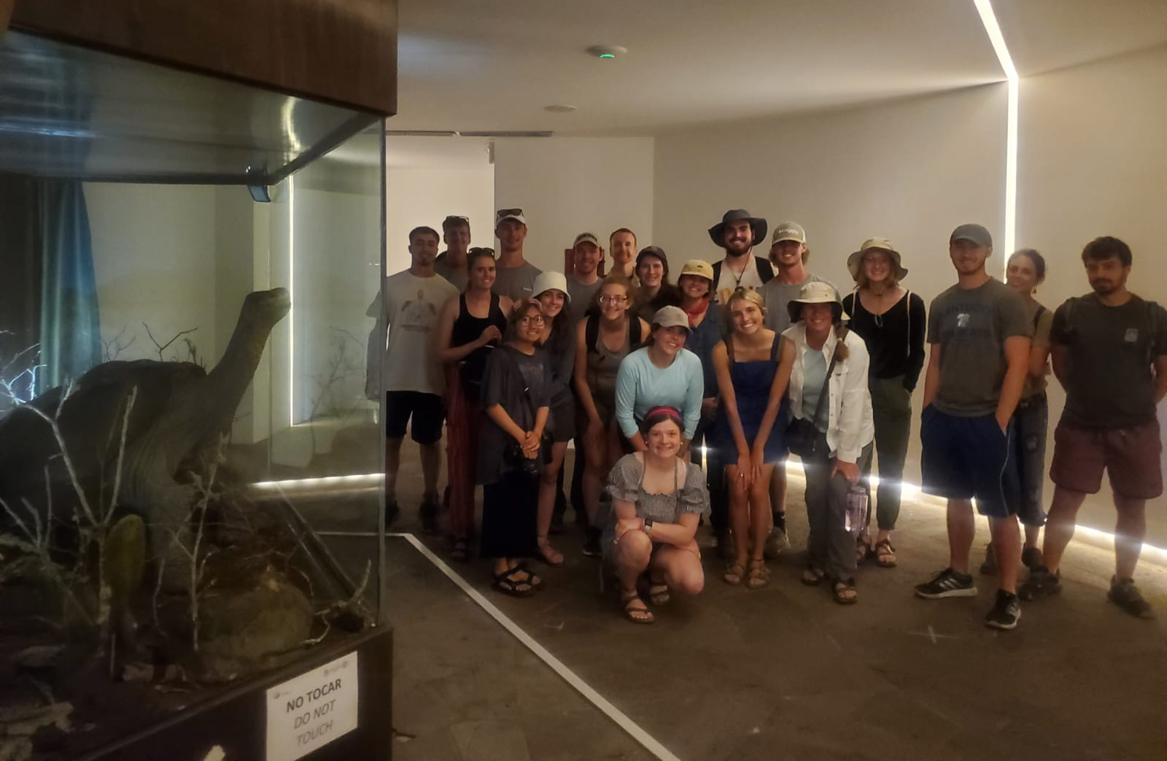
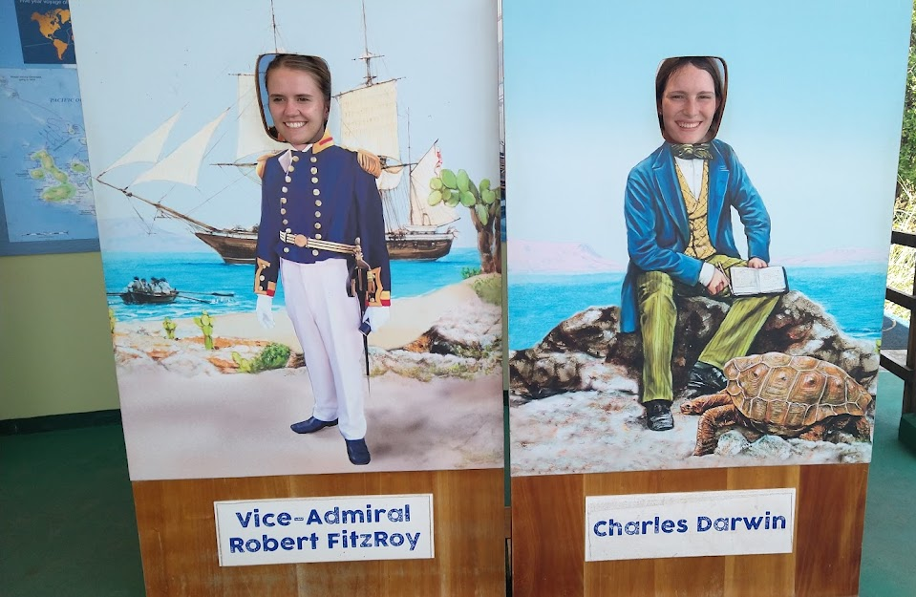
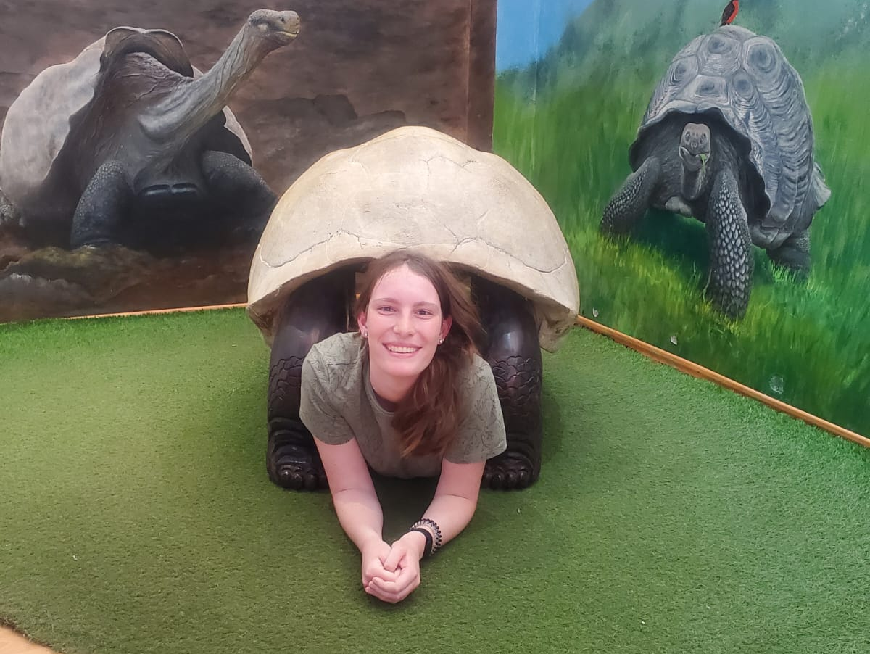
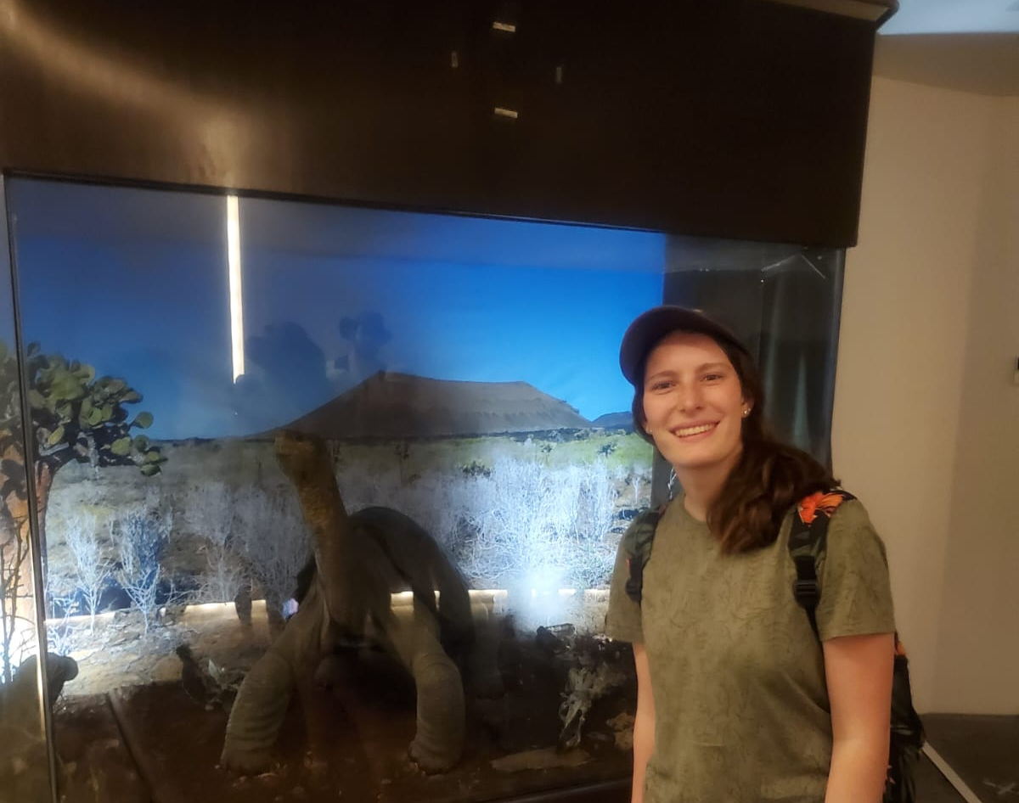

Slide 20
Blue-Footed Boobies

Slide 21
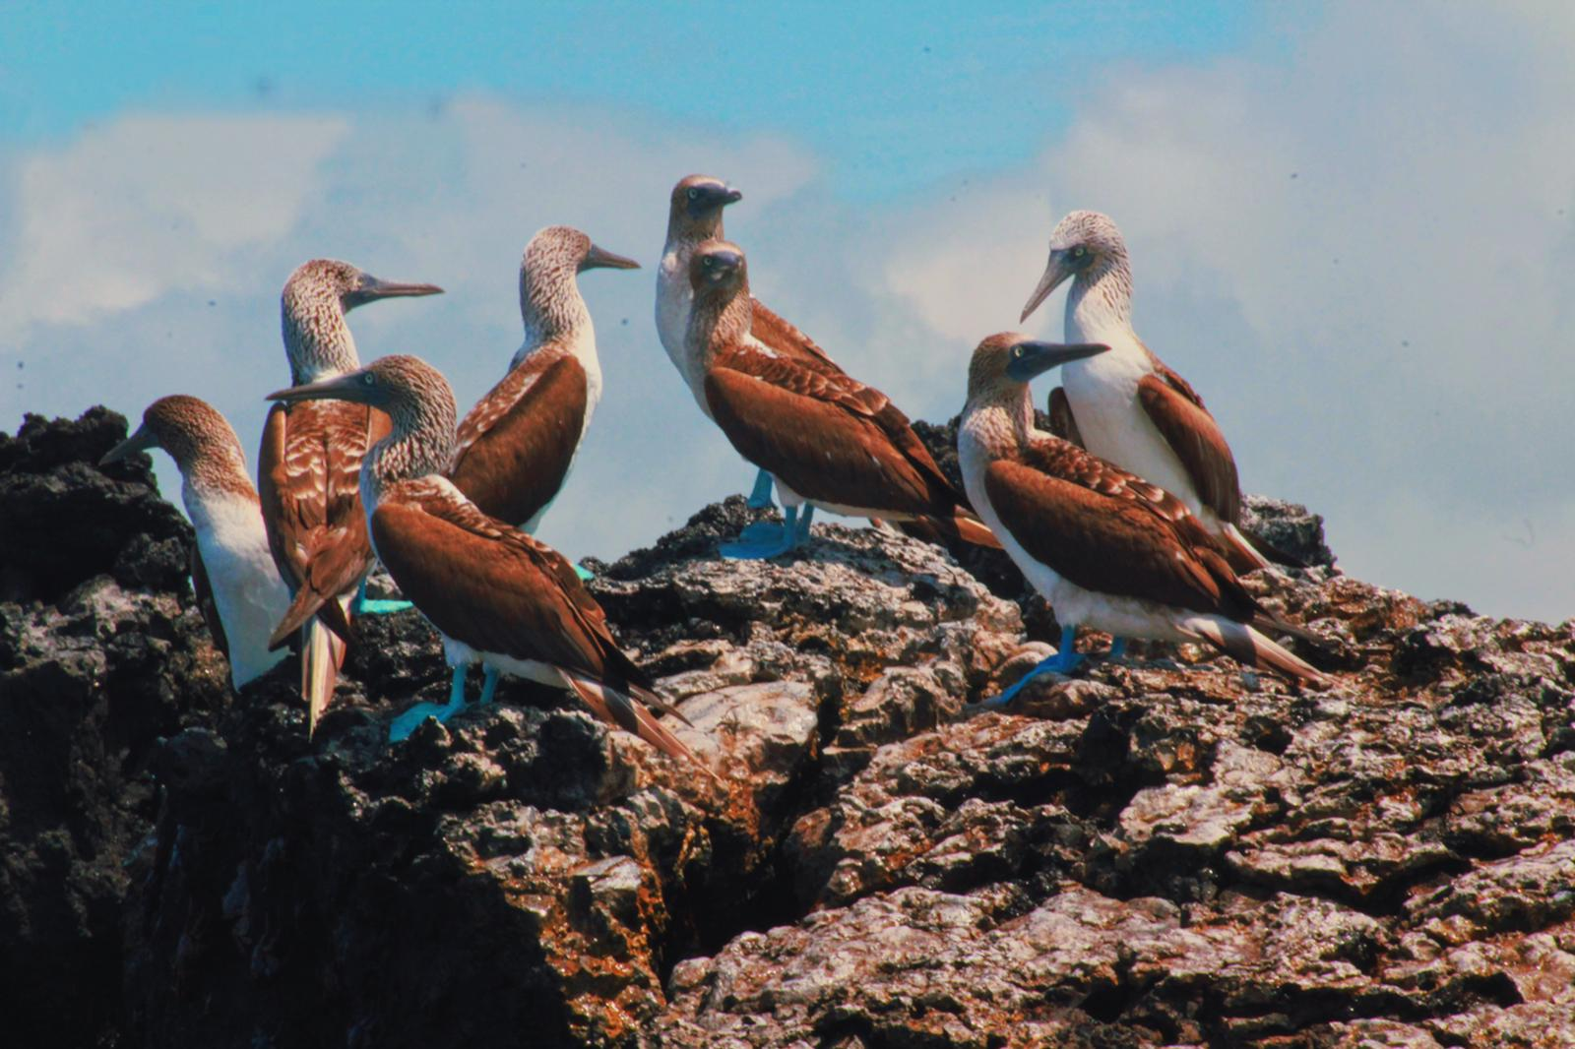
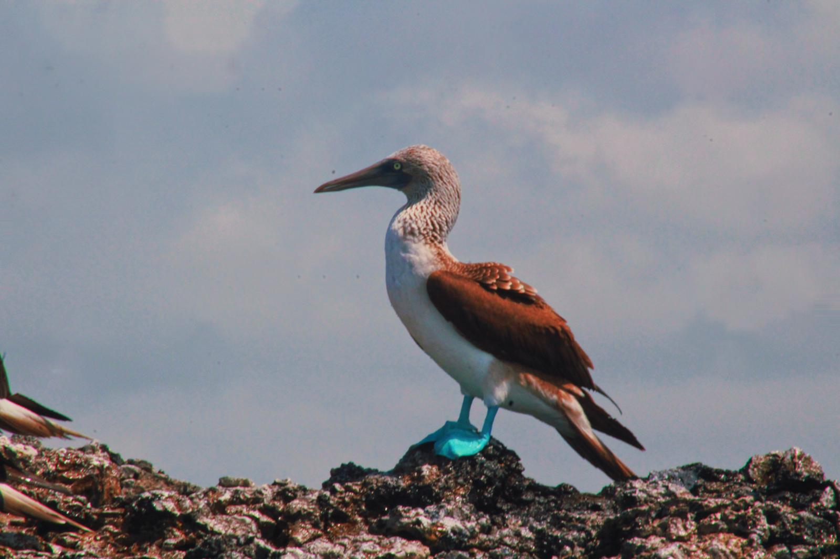
Kayaking to See Boobies

Slide 23
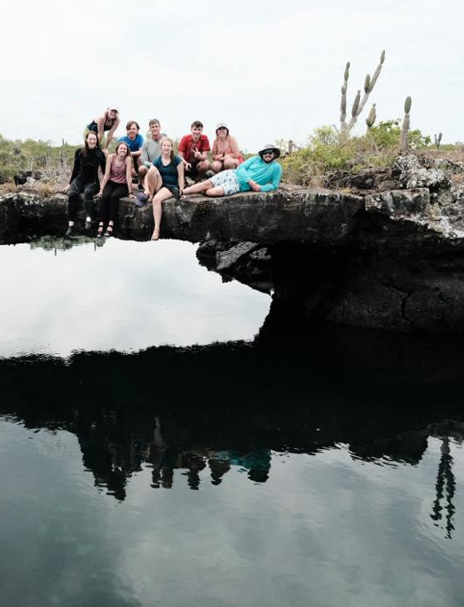
Los Tuneles

Slide 24
Marine Iguanas

Slide 25
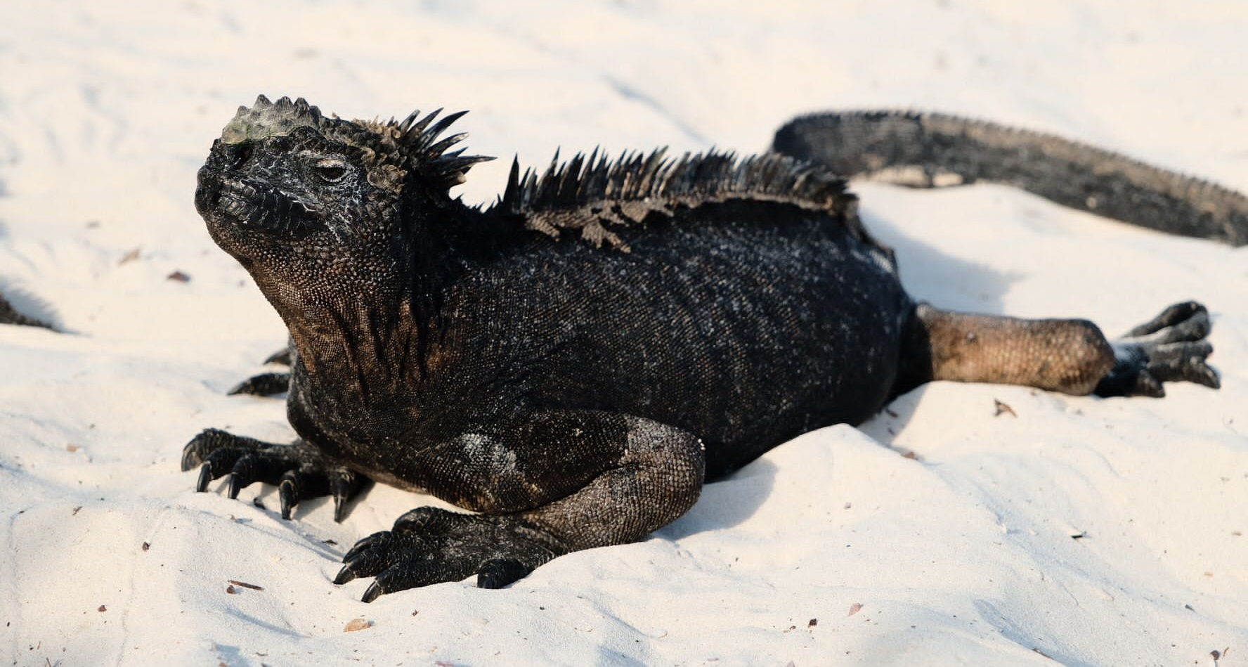
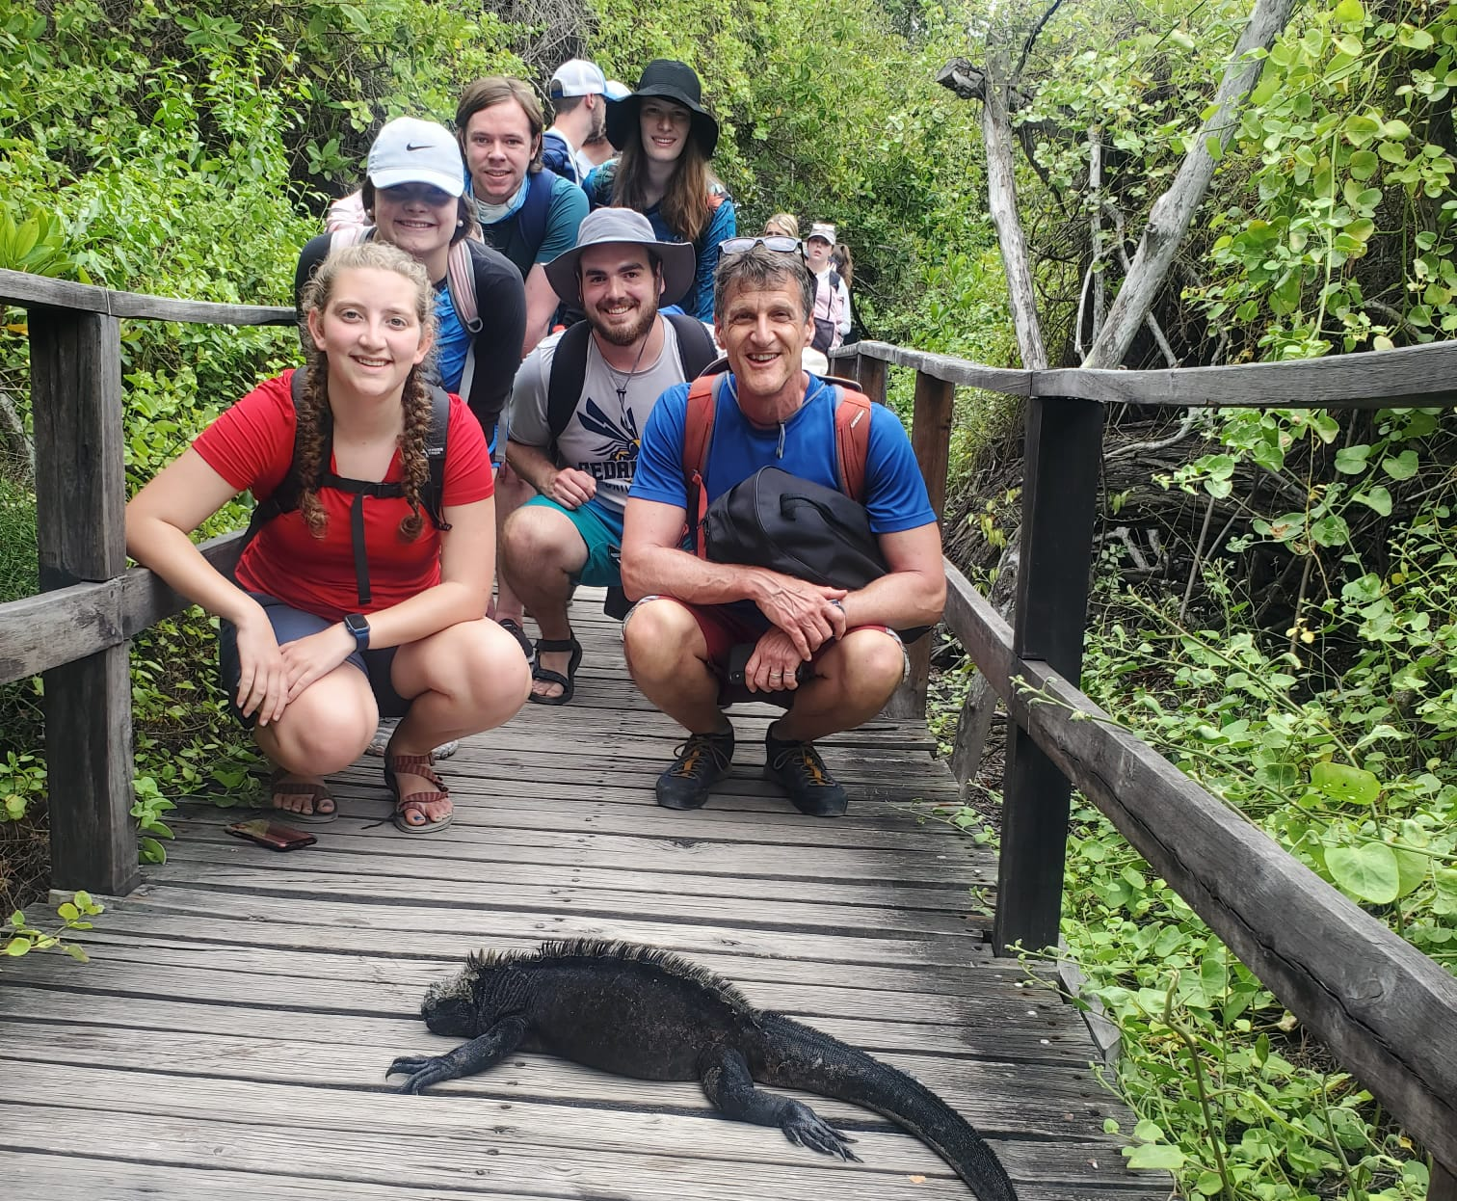
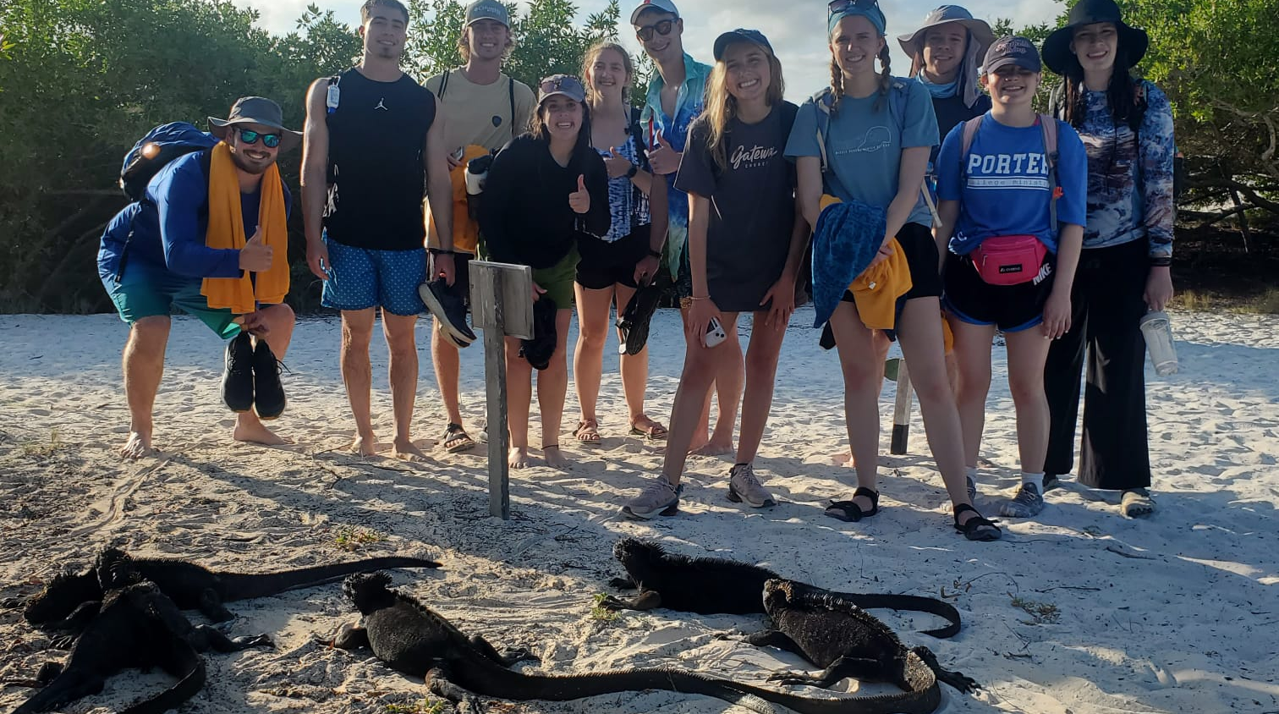

Slide 26
Sea Lions

Slide 27
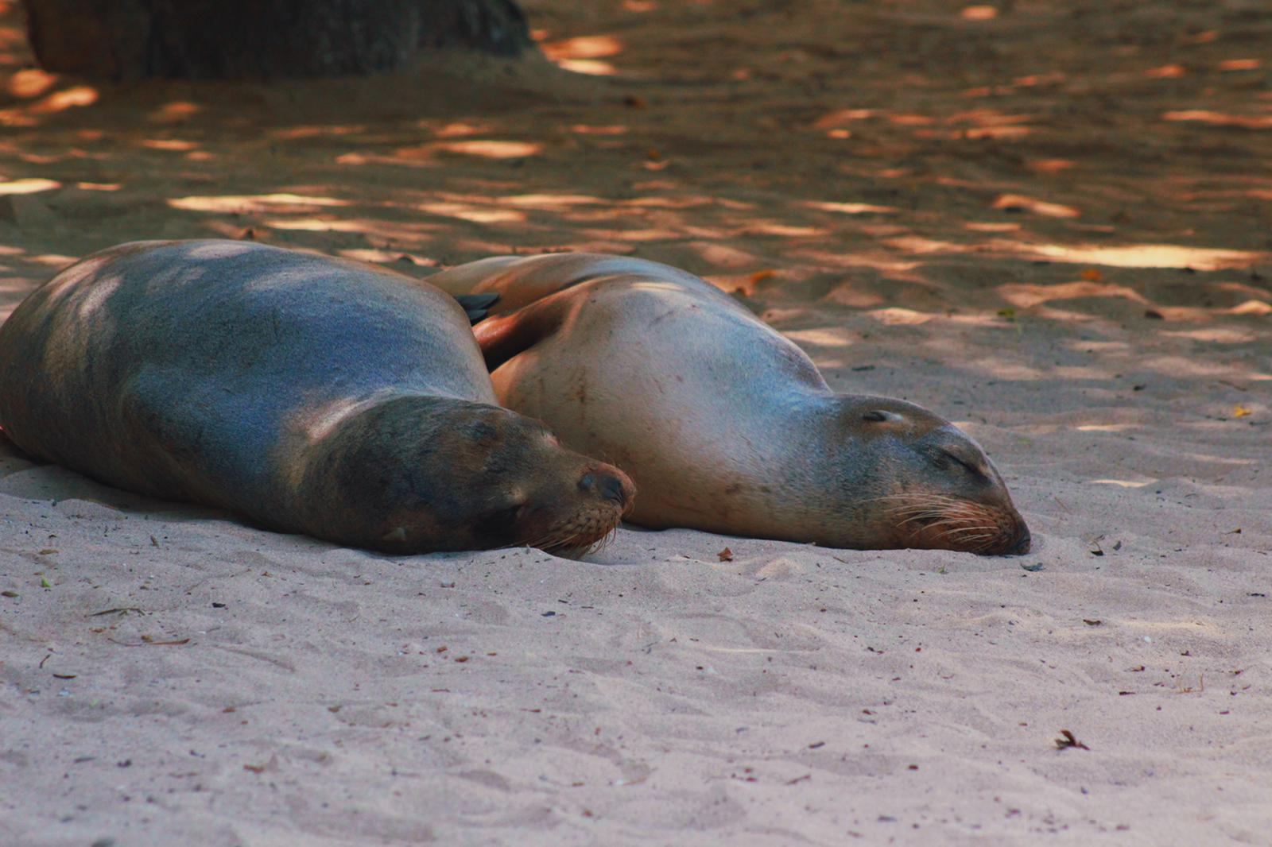
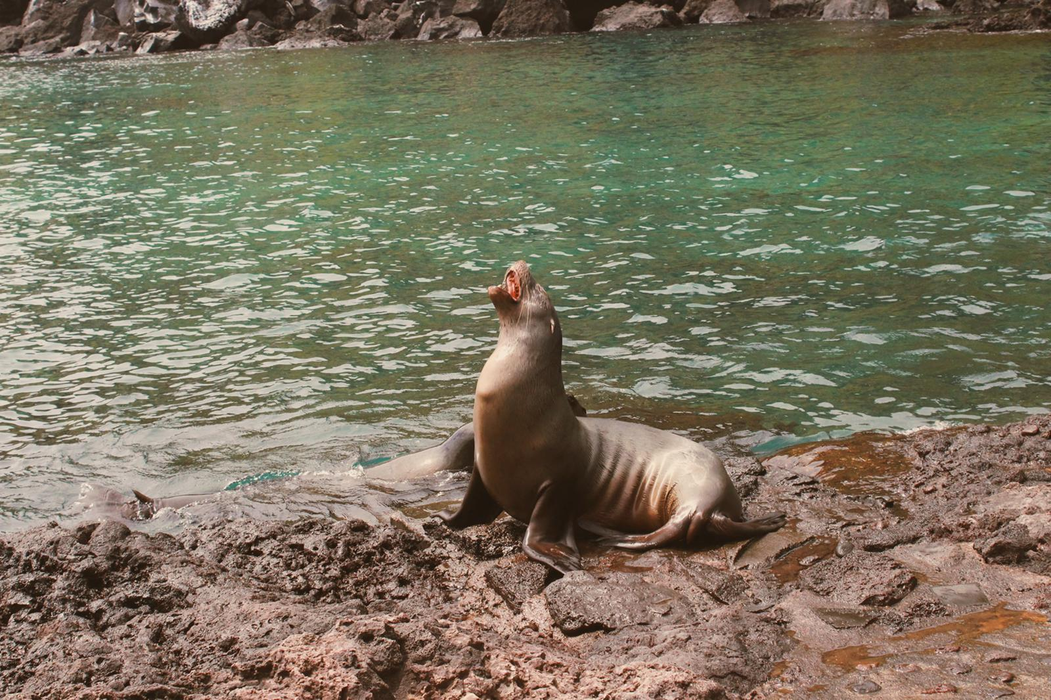
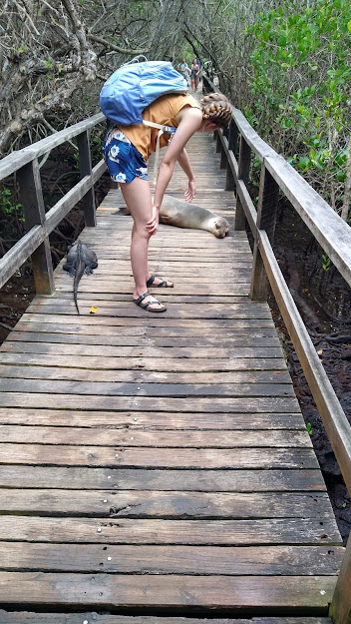
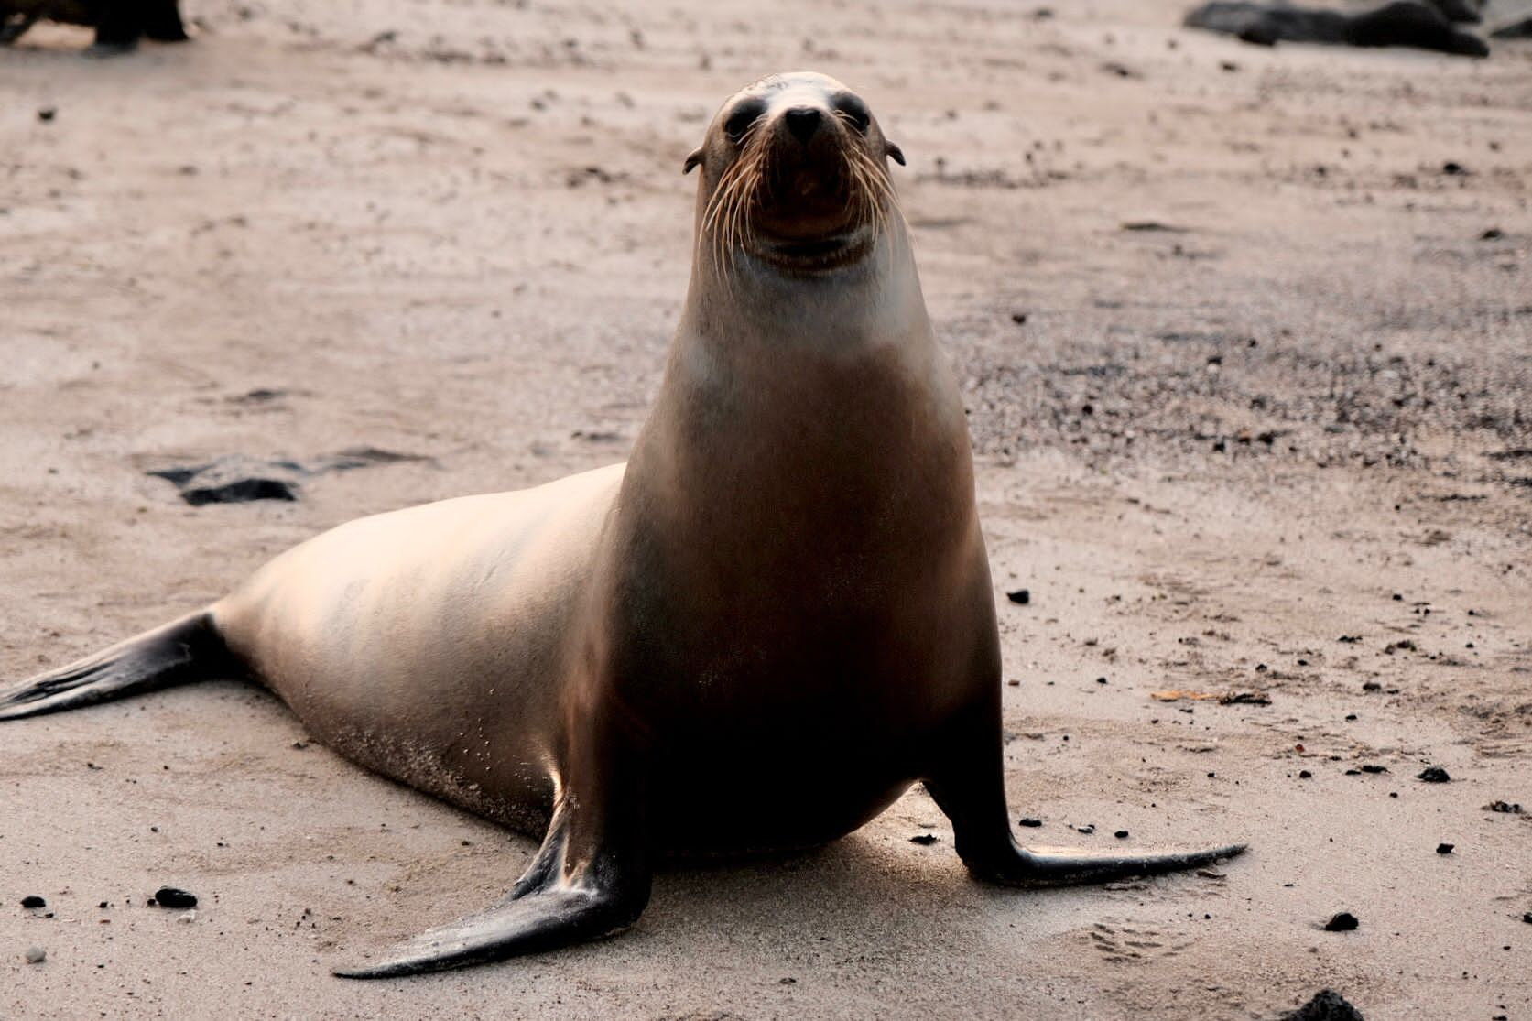
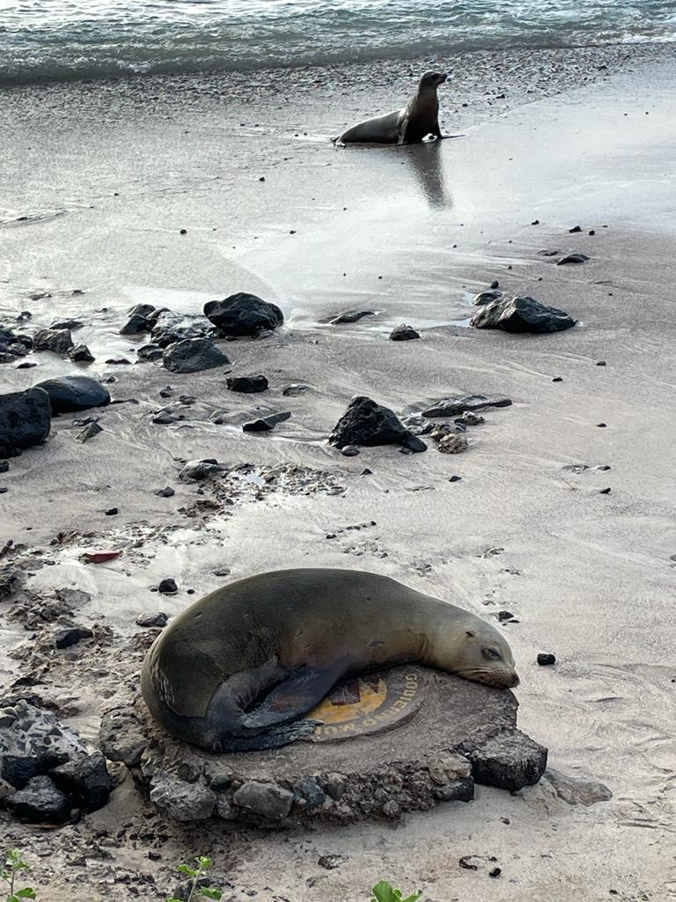
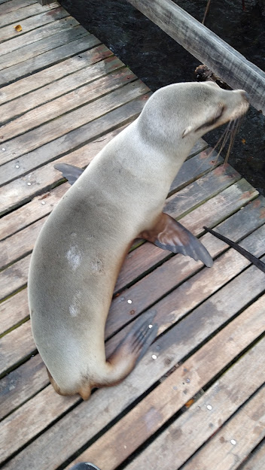

Slide 28
Hiking

Slide 29
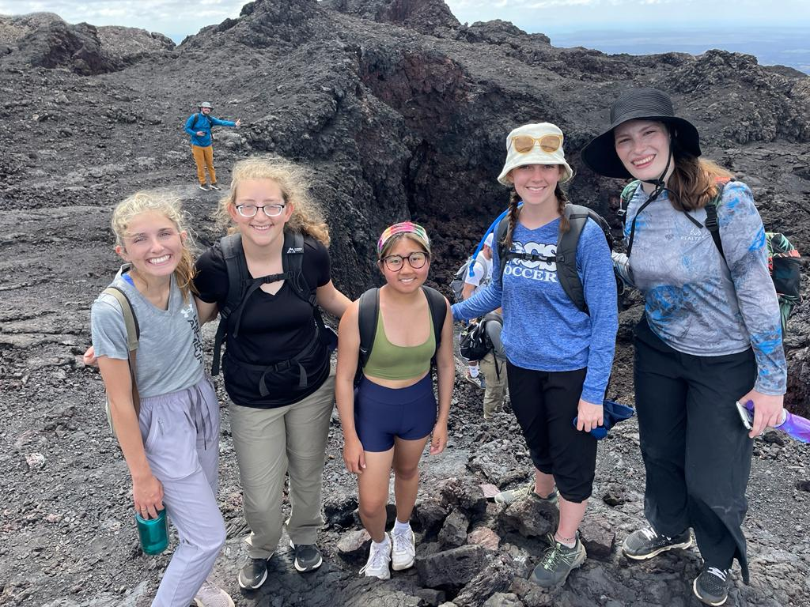
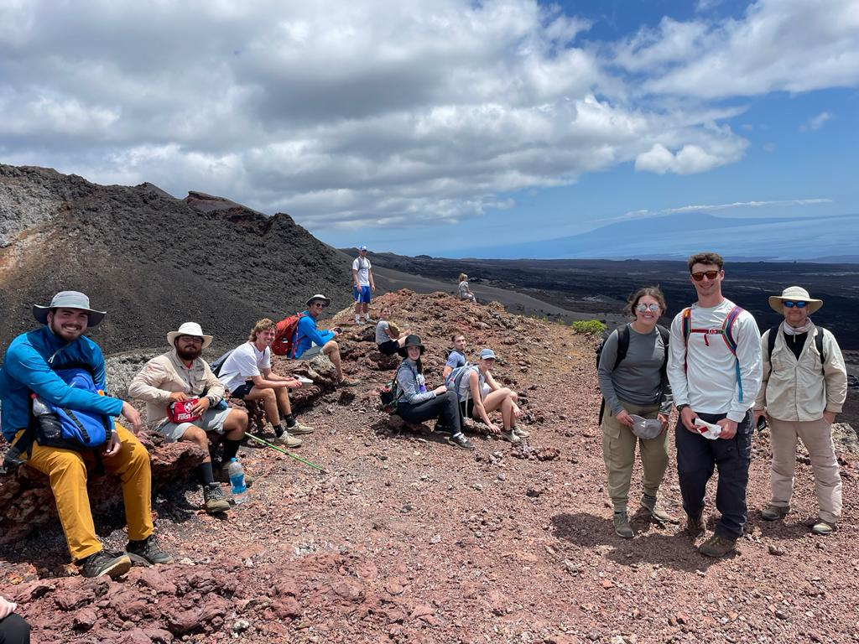

Slide 31
Boats

Slide 33
Food

Slide 37
More Wildlife

Slide 40
Fun With Friends

Slide 44
Meeting Yea-Yea

Slide 45
Going Home

Slide 47
Galapagos 2022!

