Slide 1
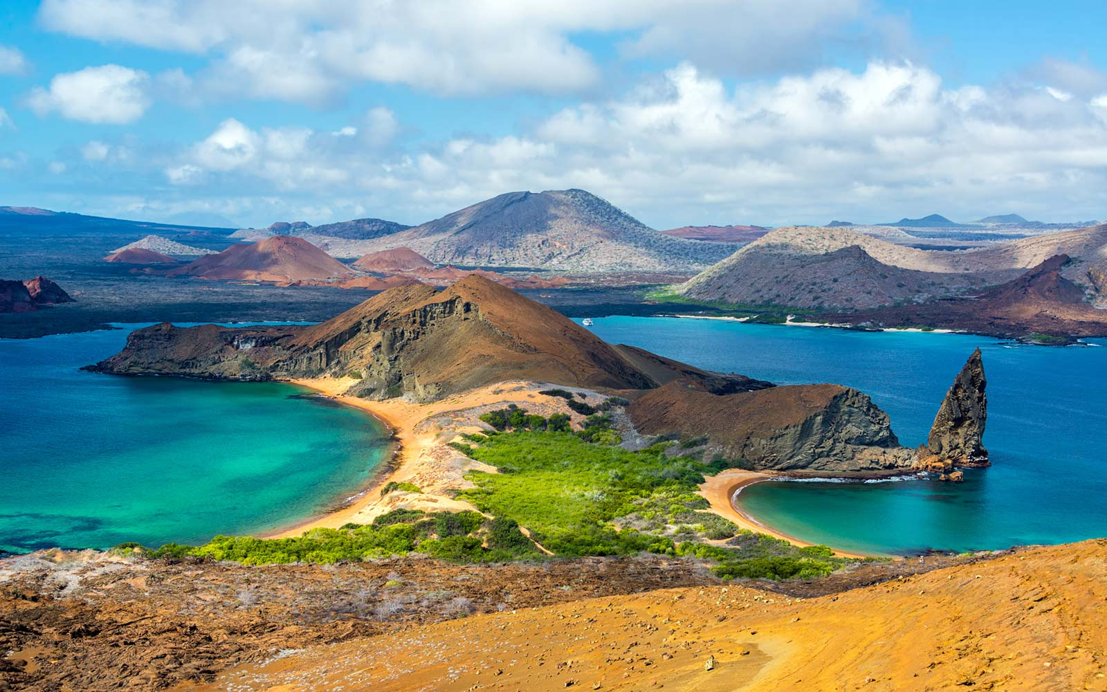
The Galapagos: Island Biogeography Meeting #2

Slide 2
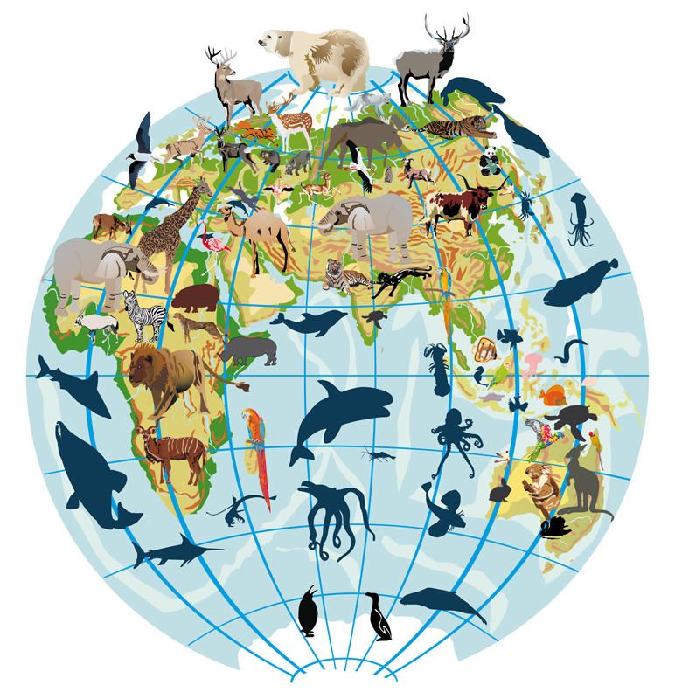
Biogeography
The study of the geographical distribution of organisms
Unites concepts from:
Ecology
Evolutionary biology
Taxonomy
Genetics
Geology

Slide 3
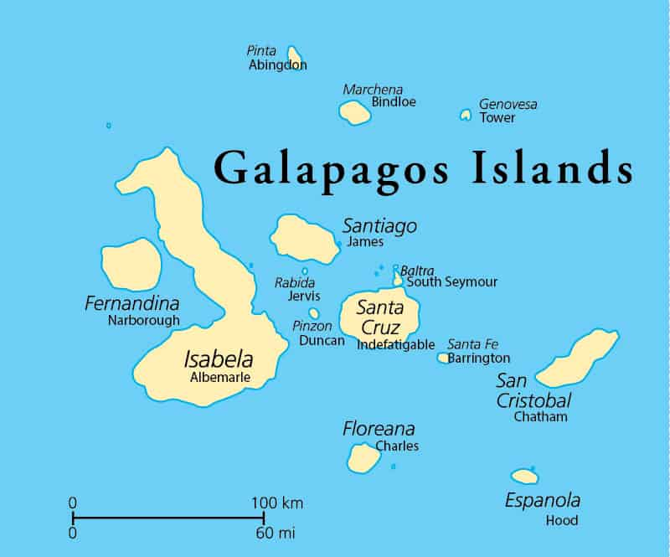
Island Biogeography
The study of isolated populations
Darwin (1860’s), MacArthur and E.O. Wilson (1960’s)
Isolated populations:
Less area
Fewer species
Alterations in populations/communities
are more easily observable
Endemic species
What makes Galapagos unique?

Slide 4
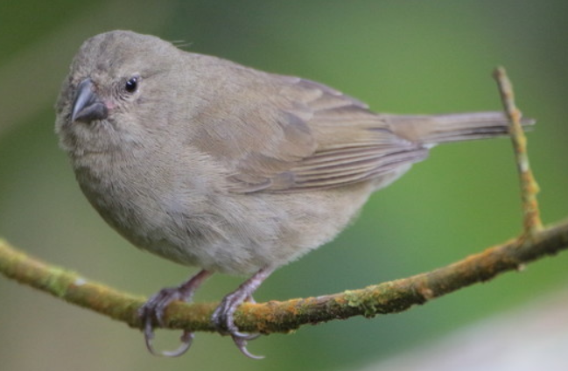
Galapagos Finches
Approximately 14 species
Monophyletic versus paraphyletic
Shares ancestor with Tiaris genus
2.3 MYA
Tiaris obscura, Dull-colored Grassquit

Slide 5
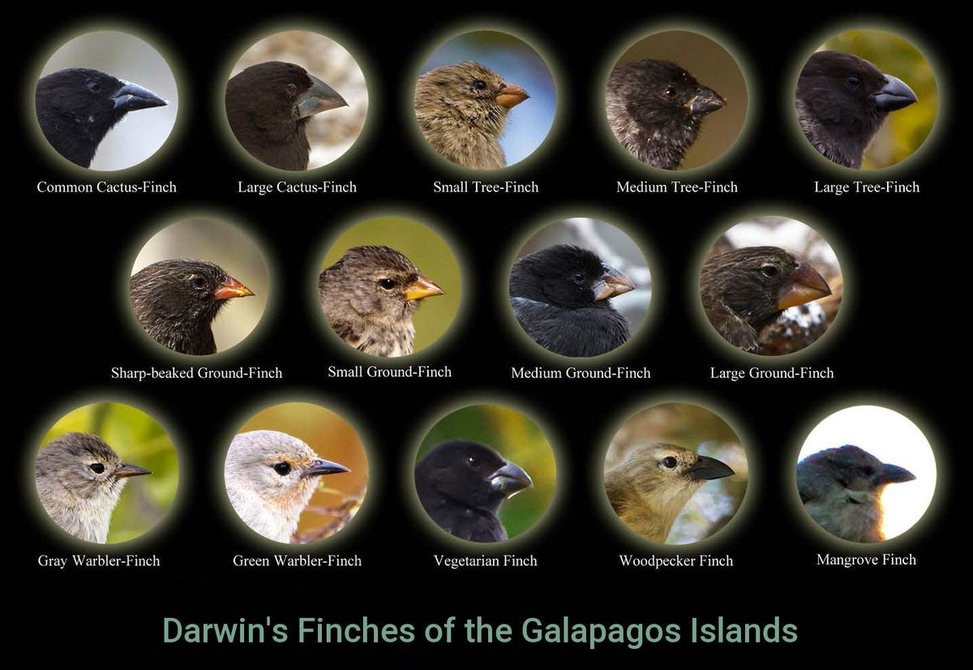

Slide 6
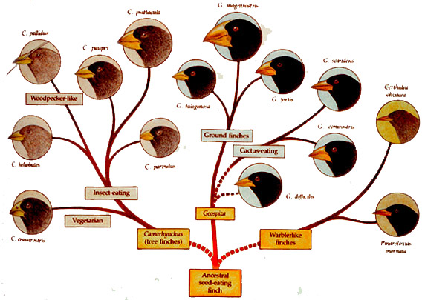
Adaptive Radiation
- Alteration of an ancestral species to fill various niches

Slide 7
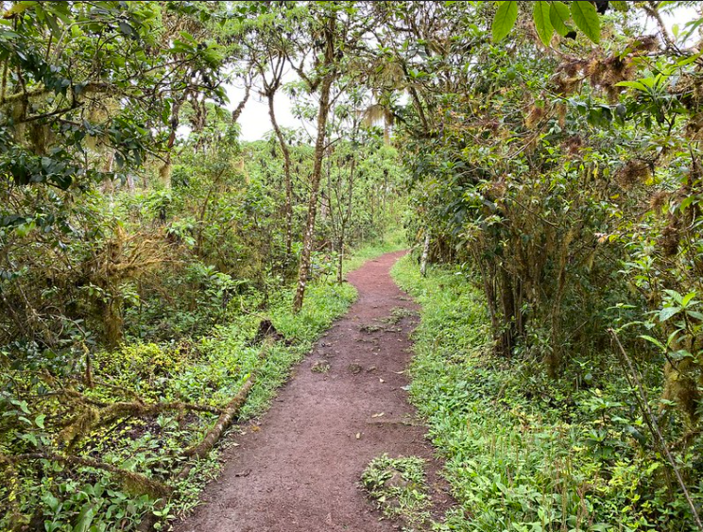
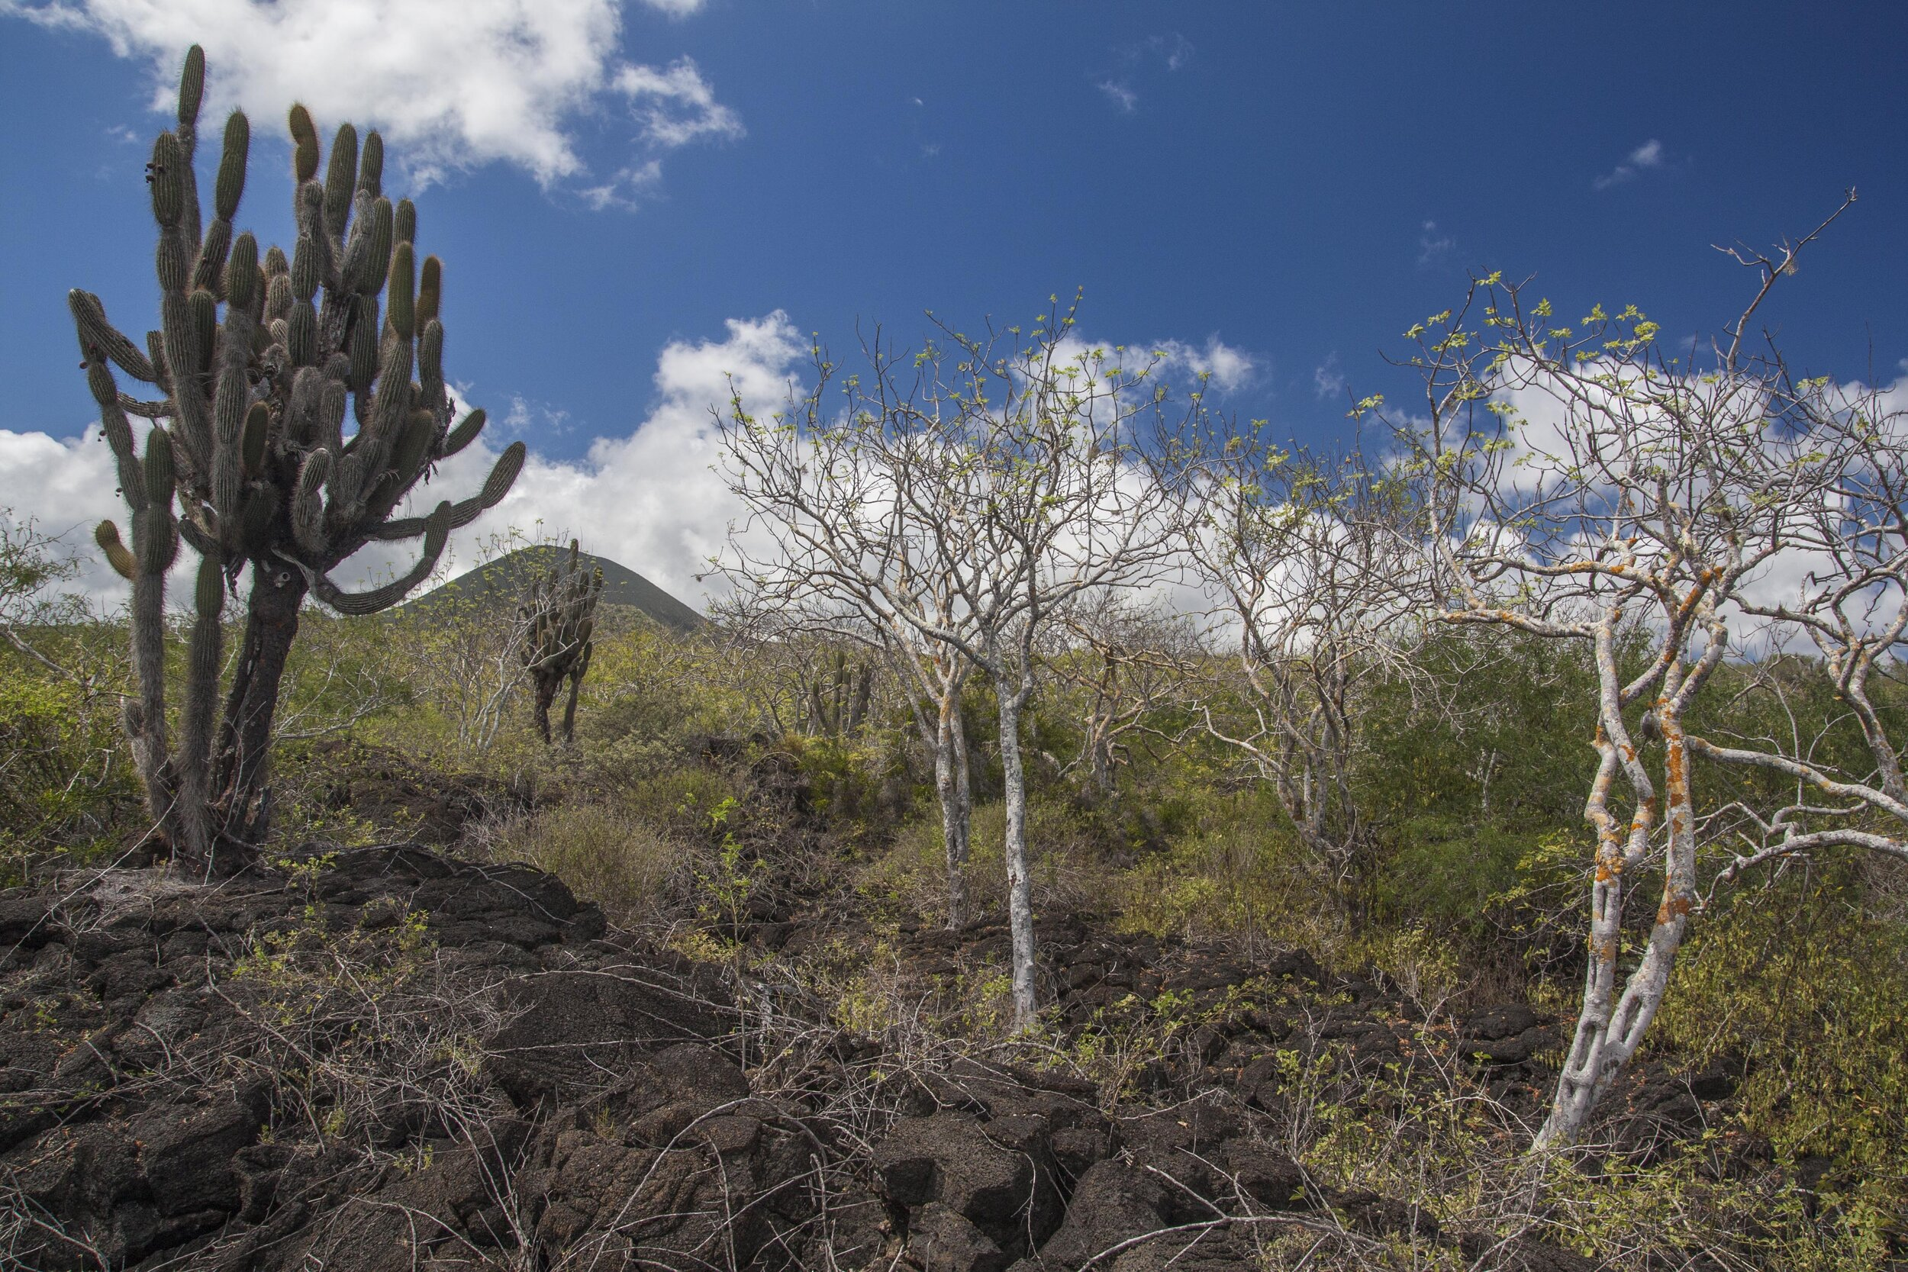
Adaptive Radiation – How?
- Natural selection – Differential contributions to the next
generation based on fitness - Niche – Relationship of a species to biotic and abiotic
factors

Slide 8
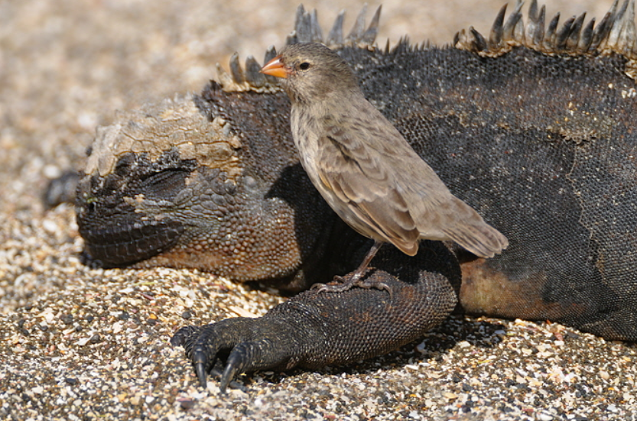
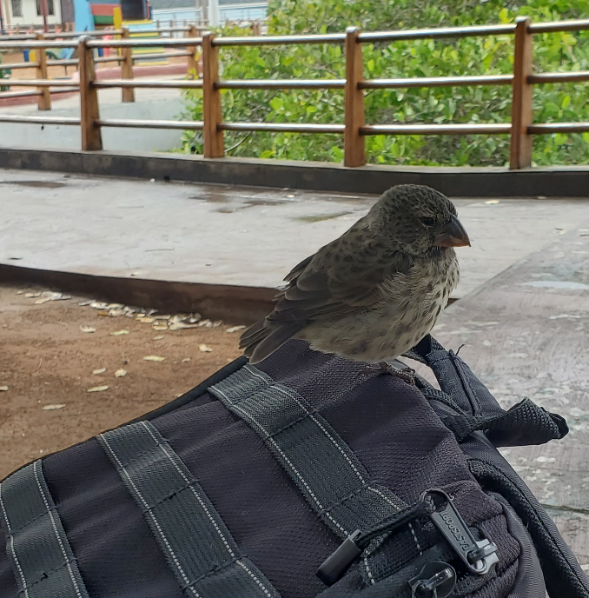
Finch Niches
Small Ground Finch - Geospiza fuliginosa
- Feeds on seeds on parasites from tortoises and iguanas
- Found on every island except Wolf, Darwin, and
Genovesa

Slide 9
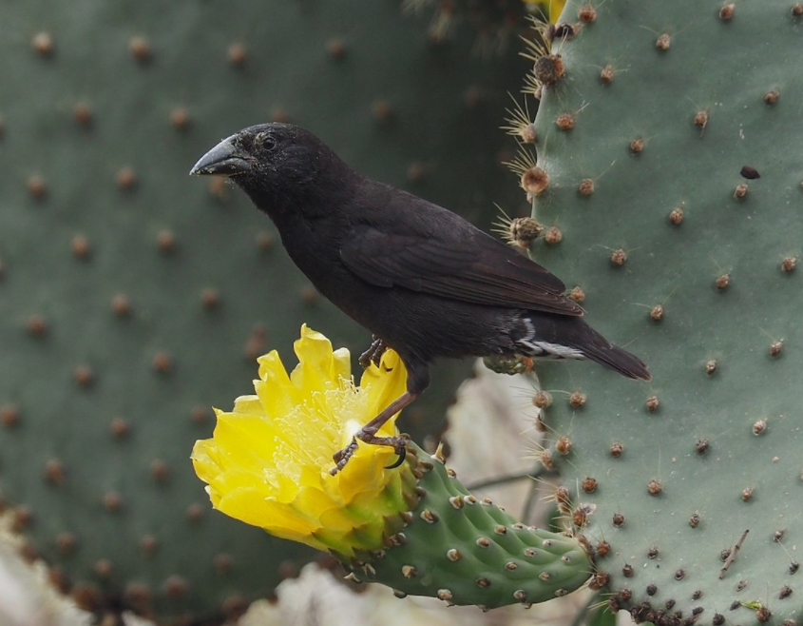
Finch Niches
Common Cactus Finch - Geospiza scandens
- Feeds on pulp, fruit, flowers, and insects associated with cacti
- Found on most islands, only in arid lowlands
- Nests in cacti

Slide 10
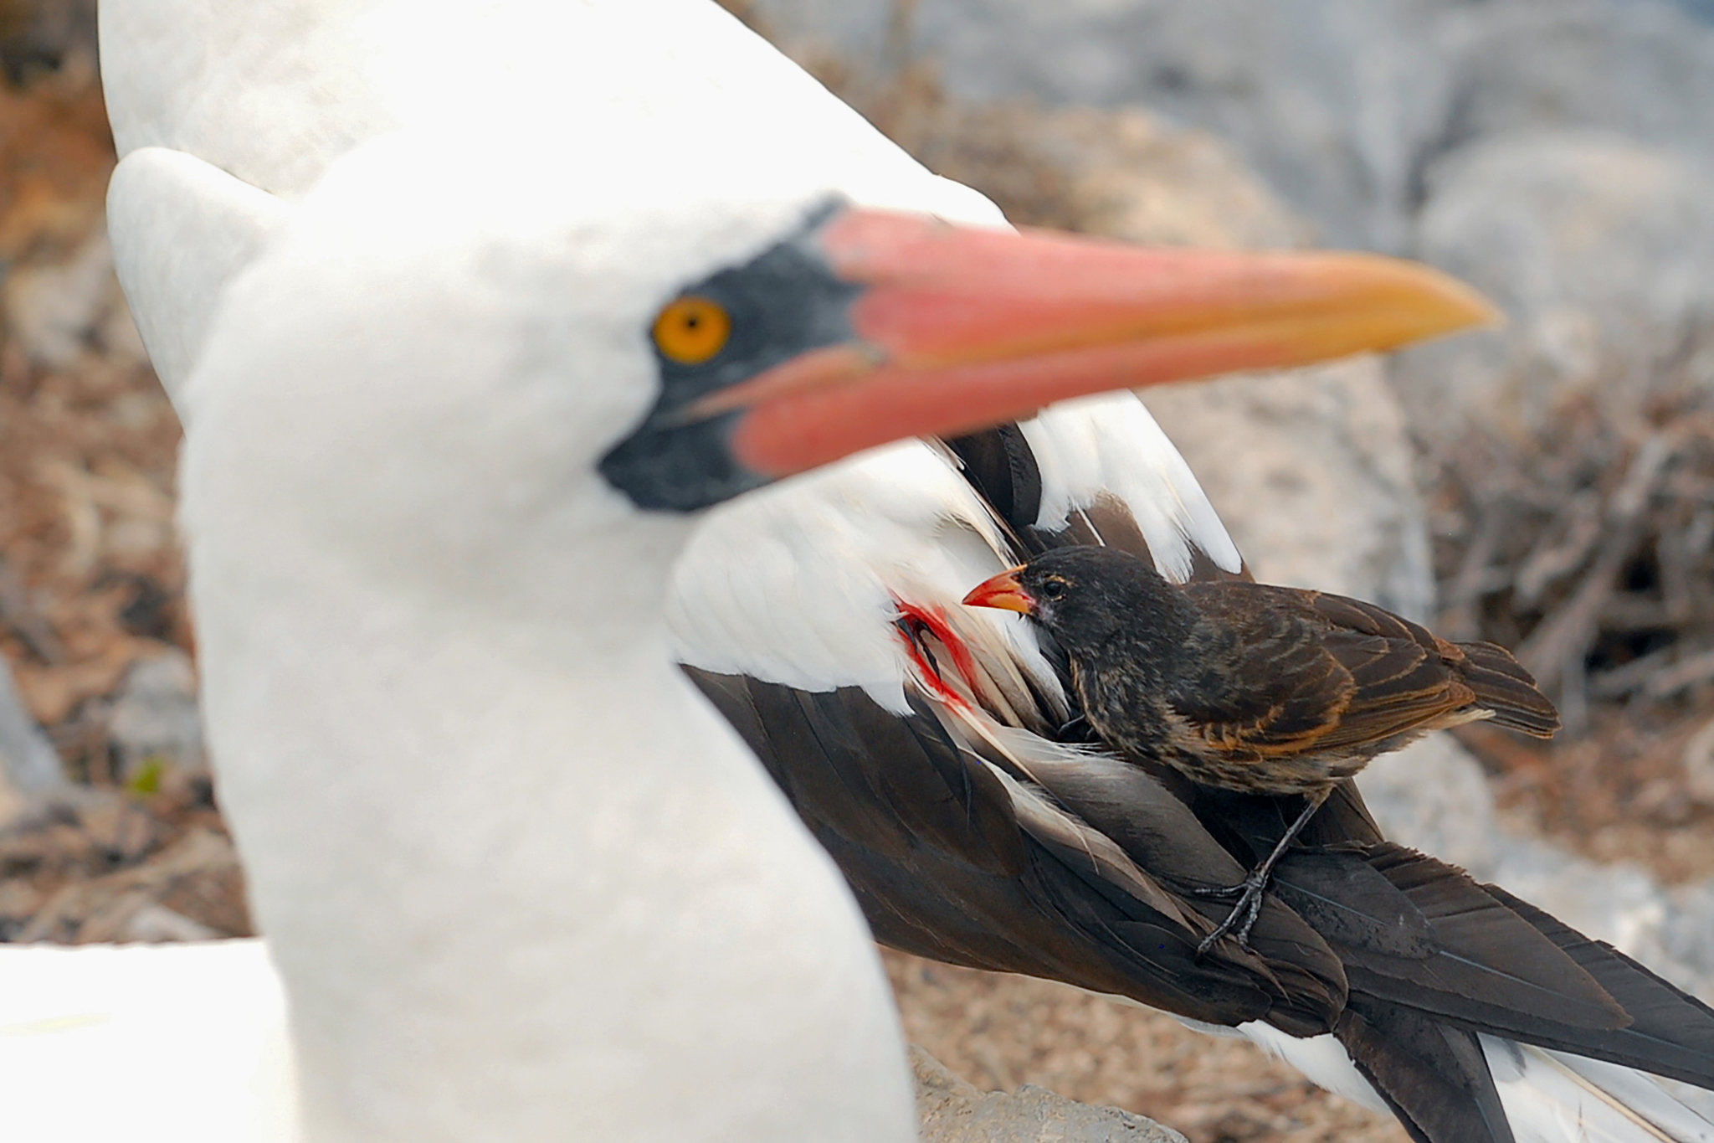
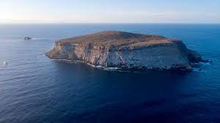
Finch Niches
The Vampire Finch - Geospiza difficilis septentrionalis
- Subspecies of sharp beaked ground finch
- Found only on Darwin and Wolf island
- Harsh environments

Slide 11
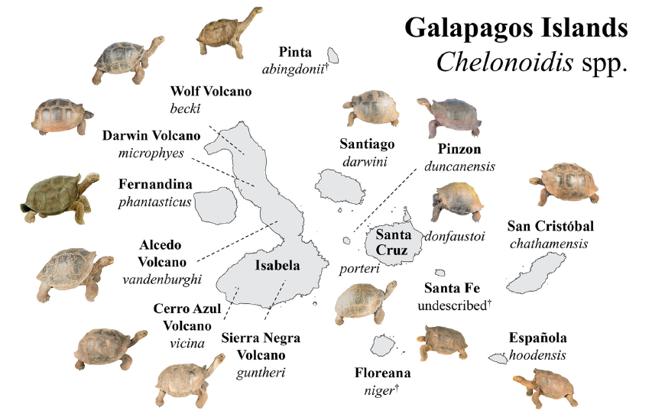
Galapagos tortoises
56 species of reptiles total
15 species of tortoises
Status
3 extinct
2 mid-1800’s
1 2021 (George)
6 crit. Endangered
3 endangered
3 vulnerable

Slide 12
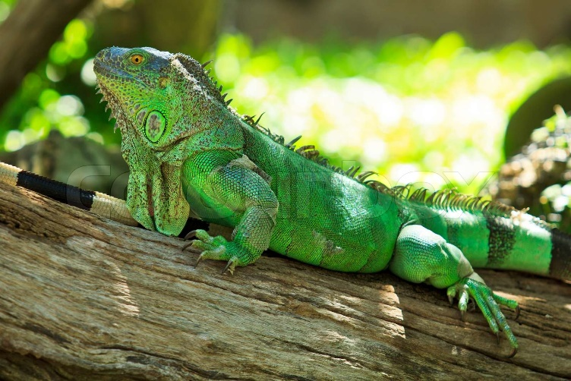
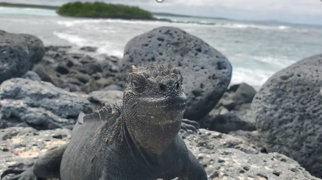
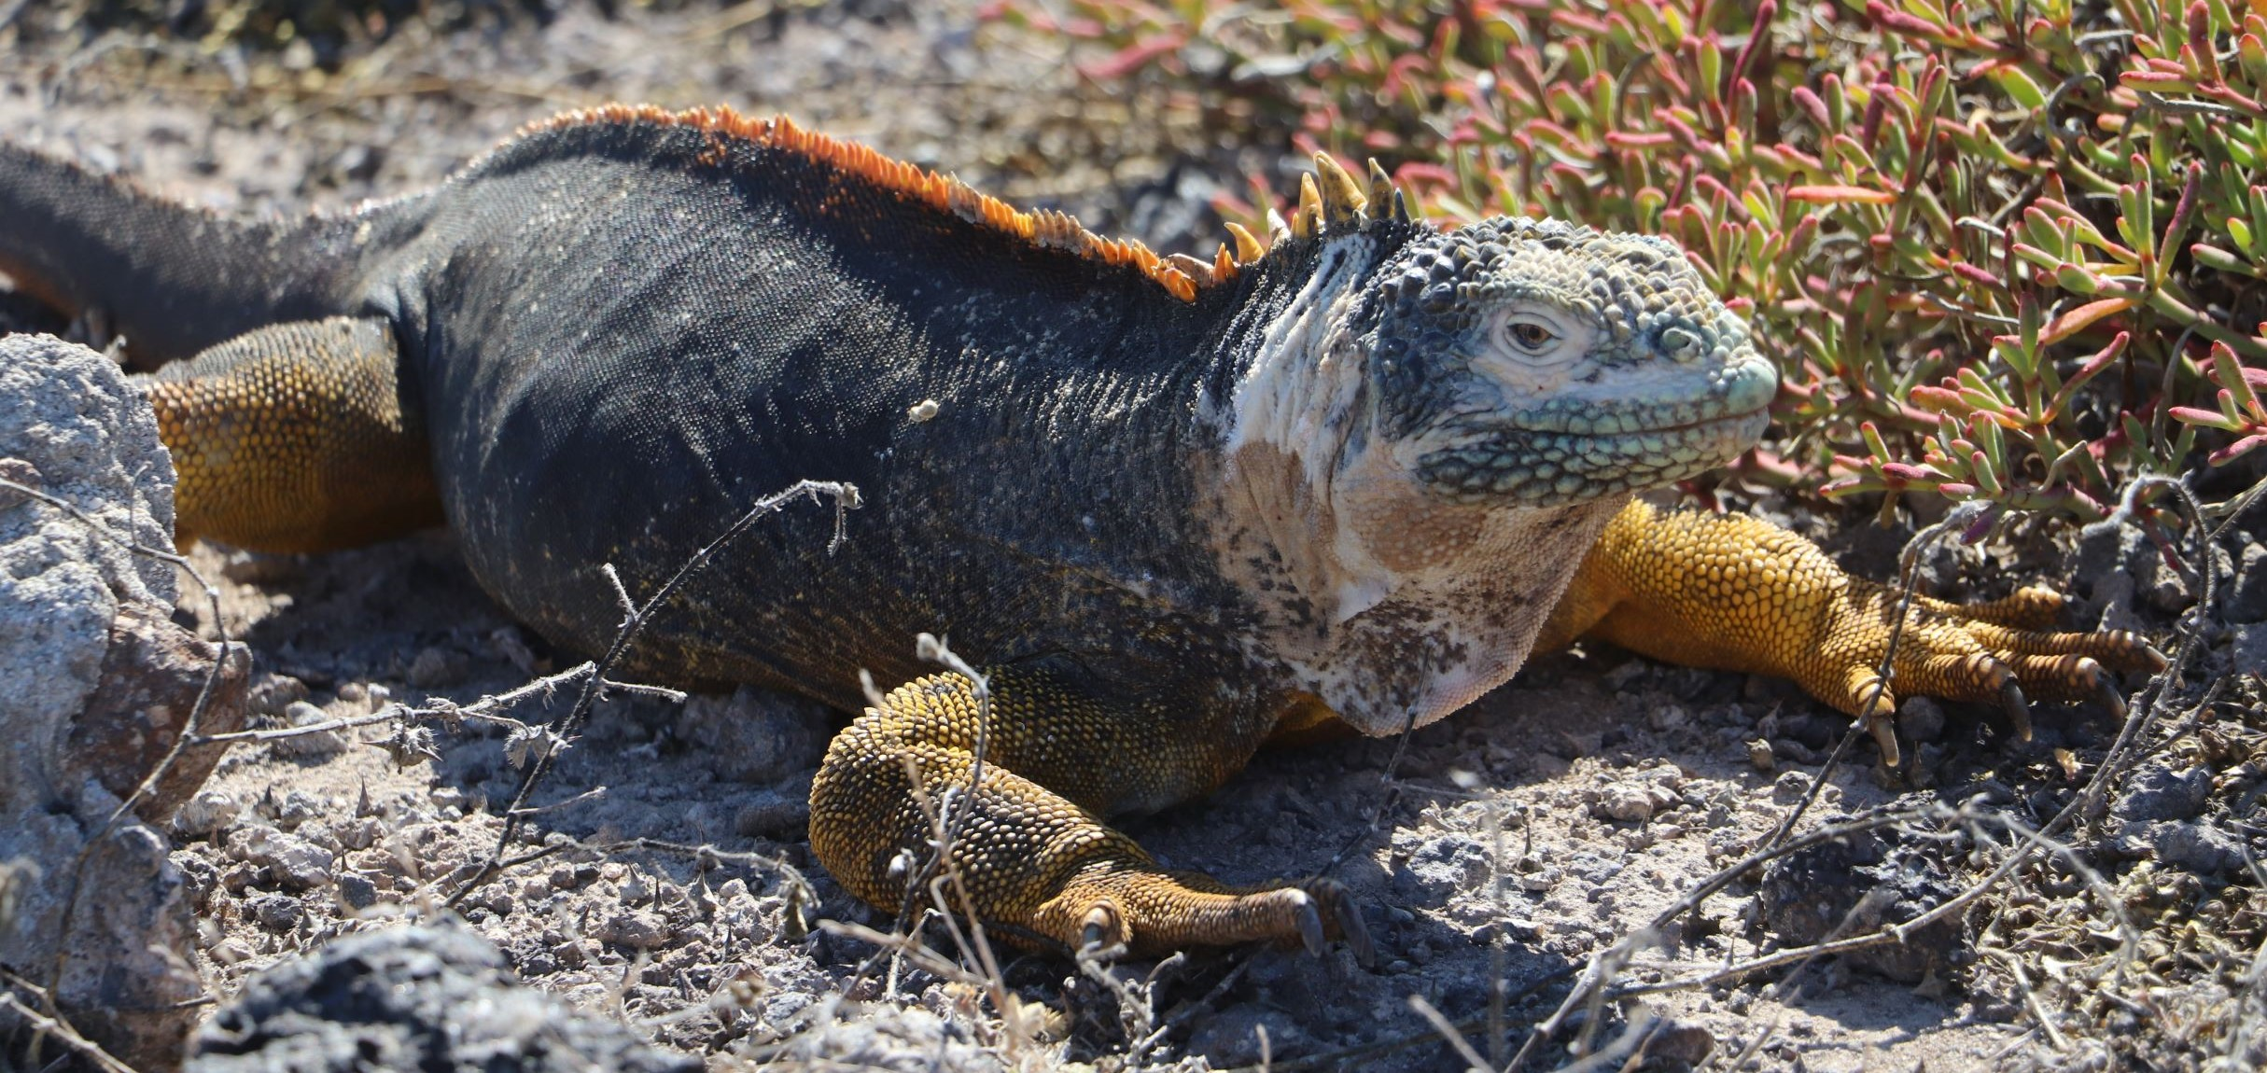
Galapagos iguanas
Mainland ancestor -Iguana iguana
Marine - Amblyrhynchus cristatus, 11 subspecies total
Terrestrial –
Conolophus subcristatus,
3 species total

