Slide 1
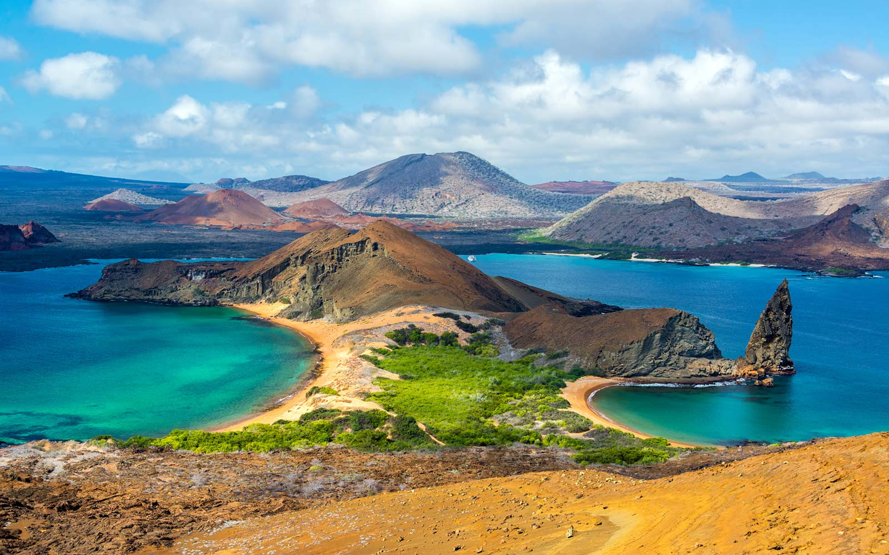
The Galapagos: Overview and Brief History

Slide 2
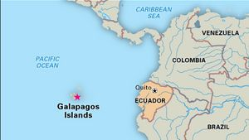

Slide 3
Galapagos Islands
- 127 islands, islets, and
rocks - 19 are large, 4 inhabited - 97% of surface was
declared a national park in
1959 - Galapagos Marine Reserve
was created in 1986 - Extending 40 miles from
outermost islands - Approximately 30,000
people live on the islands

Slide 5
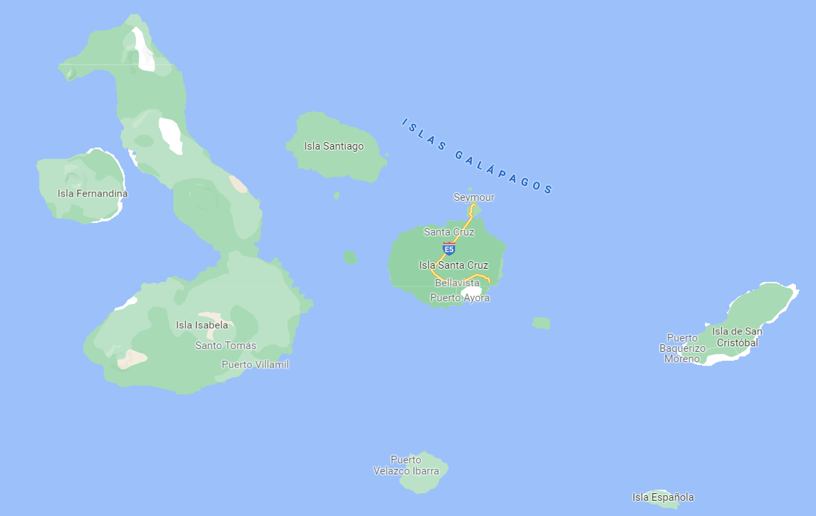
2022 Galapagos Trip

Slide 6
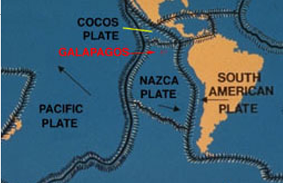
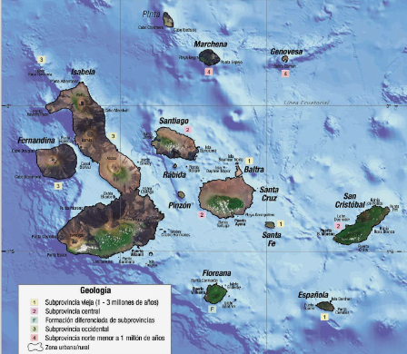
Formation of the Galapagos
- Volcanic islands
- Sitting on the Nazca plate
- Moving east/southeast, 5 cm per year
- Hotspot is currently under Isabela/Fernandina
- All the Galapagos are young (less than 5 MYA)
- Oldest islands are to the east (San Cristobal, Espanola), youngest to the west (Isabela, Fernandina)

Slide 7
Wolf Volcano (Volcan Wolf) erupting, May 26, 2015

Slide 9
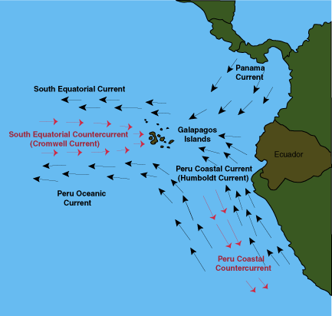
"Considering that these islands are placed directly under the equator, the climate is far from being excessively hot; this seems chiefly cause by the singularly low temperature of the surrounding water, brought here by the great southern Polar current. -Charles Darwin, The Voyage of the Beagle , 1845 Climate influenced by 3 main currents: s 1. Humboldt 2. Panama 3. Cromwell

Slide 10
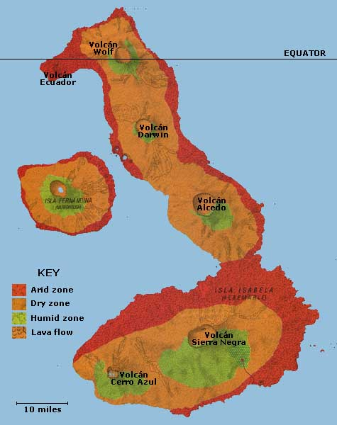
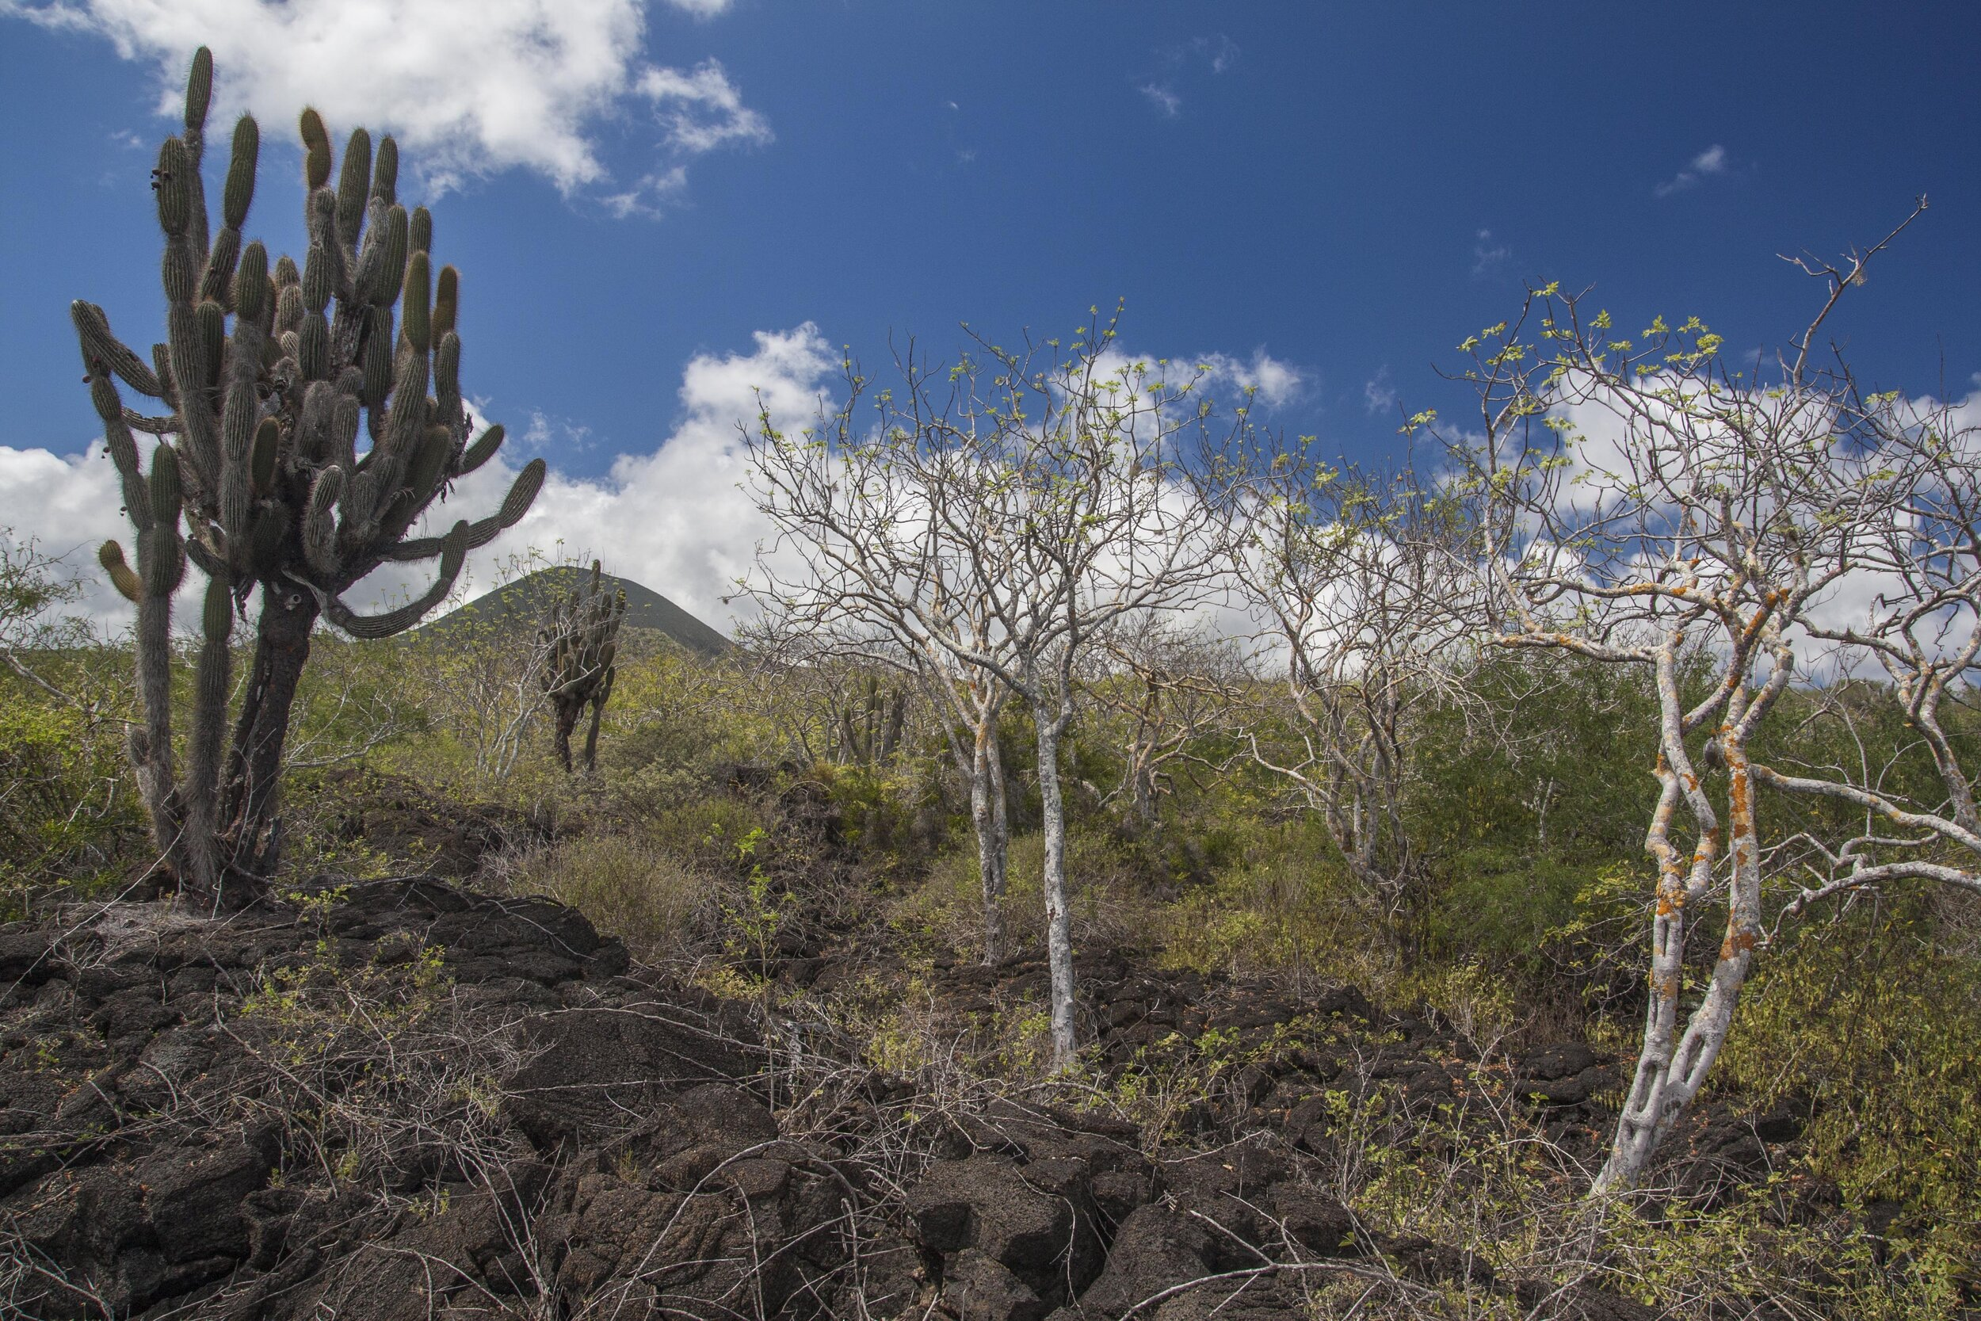
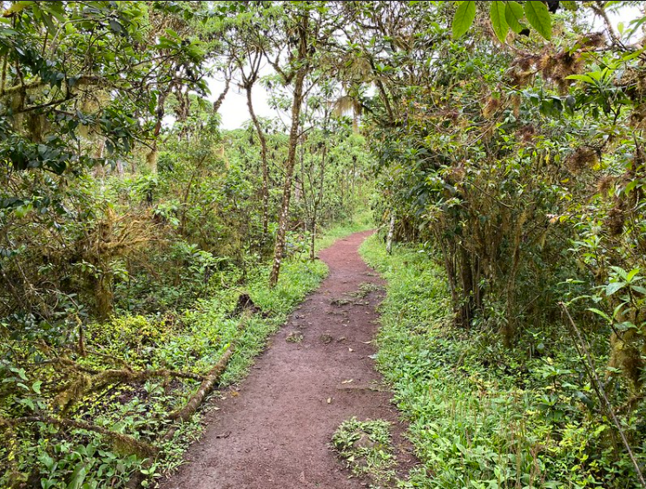

Slide 11
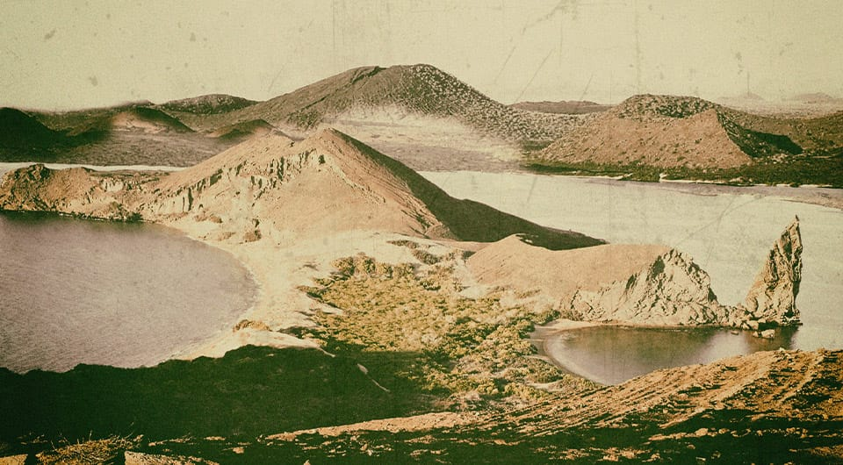
Brief Galapagos History
Discovered by western world in 1535
- Bishop of Panama, described harsh, desert-like conditions
Primarily utilized by pirate and whalers through 1800
- Nice location for both, sperm whales and trade route
- Killed 1000’s of tortoises
Annexed by Ecuador in Feb. 12, 1832
Small communities established
Darwin
Voyage Dec. 27, 1831 – Oct. 2, 1836
In Galapagos Sept. 15, 1835 – Oct. 17th

Slide 12
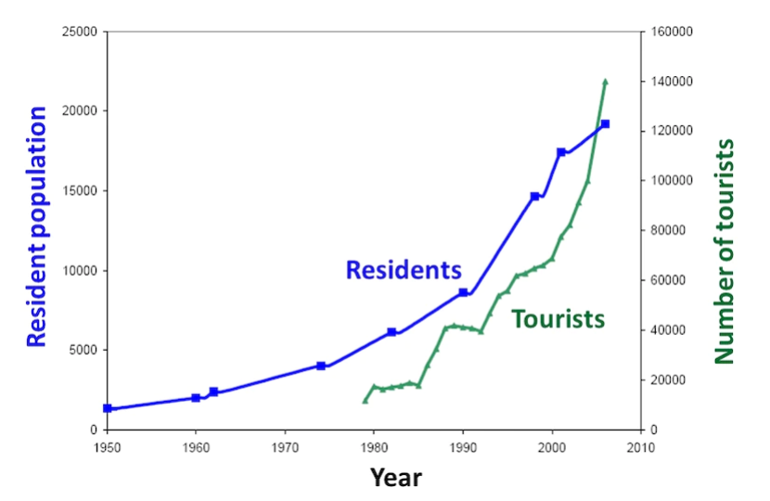
Brief Galapagos History
Anthropogenic impact
Tortoise capture, introduced species, fires
First wildlife sanctuaries 1934
NP established in 1959

